Slide 1
Impacts of the Broadband Initiatives Program by Race & Ethnicity
John Pender*, Joshua Goldstein**, Devika Mahoney-Nair**, Hanna Charankevich**, and Josemari Feliciano***
* USDA Economic Research Service (john.pender@usda.gov)
** University of Virginia, Biocomplexity Institute, Social and Decision Analytics Division
*** USDA Rural Development Innovation Center
Presented at the 2022 Agricultural and Applied Economics Annual Meetings
Anaheim, California
August 1, 2022
The findings and conclusions in this presentation are those of the authors and should not be construed to represent any official USDA or U.S. Government determination or policy. This research was supported by the U.S. Department of Agriculture, Economic Research Service under Cooperative Agreement Numbers 58-6000- 8-0039 and 58-6000-1-0099.

Slide 2
Background and Rationale
Promoting deployment of broadband is a high priority of the Federal Government
More than $50 billion invested in Federal Broadband programs to date
FCC Rural Digital Opportunity Fund will invest $20 billion and the Infrastructure Investment and Jobs Act (IIJA) of 2021 will invest $65 billion
The digital divide between rural and urban areas and across race and ethnic groups is a continuing concern
17% of rural people and 21% of people on tribal lands lacked fixed terrestrial broadband service in Dec. 2019, compared to 1% of urban people (FCC 2020)
71% of Blacks and 65% of Hispanics had a home broadband connection in early 2021, compared to 80 percent of Whites (Pew Research Center)
Reducing the digital divide across race and ethnic groups is an increasing focus of Federal broadband programs
IIJA provides $2.75 billion for Digital Equity Act competitive grants, $2 billion for Tribal Broadband Connectivity Program
Little published research has investigated impacts of Federal broadband programs, none has investigated impacts by race and ethnicity

Slide 3
Research Objective
This research investigates the impacts of broadband availability and the Broadband Initiatives Program (BIP) on broadband adoption and employment, in total and by race and ethnicity

Slide 4
Outline of Rest of Presentation
The Broadband Initiatives Program (BIP)
Methods, variables, and data sources
Selected results
Discussion and conclusions

Slide 5
Broadband Initiatives Program (1)
In this study we focus on impacts of BIP grants and loans
Largest USDA broadband program implemented through FY 2021 in terms of appropriations - $2.5 billion appropriation
Limited prior research on impacts – one study by Pender et al. (2022) investigated impacts on broadband adoption and telework, but not how impacts varied across race and ethnicity
Sufficient time has elapsed to measure impacts – all projects approved in FY 2010
Eligible areas
≥ 75% of project area must be a rural area with insufficient access to high-speed broadband to facilitate economic development
“Rural area” = an area not in a town or city with > 20,000 people and not a smaller urbanized area adjacent to a city with > 50,000
Insufficient “high-speed” broadband access defined in second round as ≤ 5 mbps (upstream + downstream) in at least 50% of project area

Slide 6
Broadband Initiatives Program (2)
Eligible projects
Last mile and middle mile infrastructure projects; some second-round projects also supported satellite bb, rural libraries, and provided technical assistance
Grants in first round could only support projects serving remote unserved rural areas; this requirement dropped in second round
Standard 75% grant/25% loan used in second round
BIP infrastructure projects
299 loan and/or grant projects approved; 260 completed/39 rescinded
95% of projects last mile projects
65% of completed projects provided fiber optic to the household
1.3% of the 2010 U.S. population lived in BIP project service areas

Slide 7
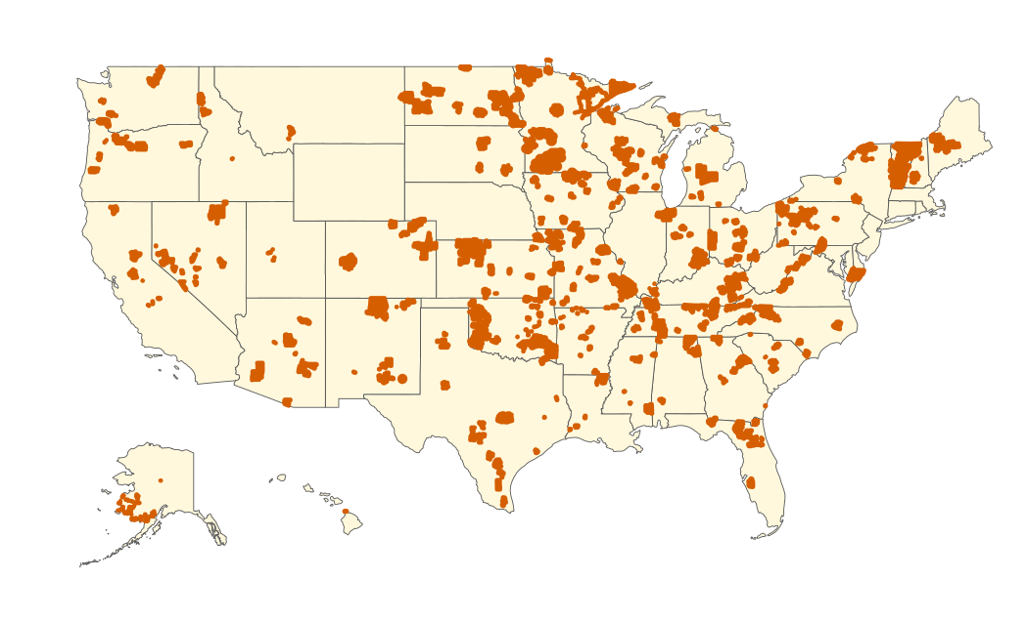
Broadband Initiatives Program (3)
Source: Authors’ analysis of RUS data

Slide 8
Analytical Methods (1)
Two methods used to estimate impacts
Ordinary least squares (OLS) growth regression at census tract level:
(1) $∆Y_{i(t1−t0)}=α+β{BIP}_{i}+γ{BB}_{it0}+{δX}_{it0}+ε_{i(t1−t0)}$
Where: - $∆Y_{i(t1−t0)}$ is the change in the outcome variable in tract i from t0 to t1
- ${BIP}_{i}$ is a dummy variable = 1 for BIP tracts, 0 otherwise
- ${BB}_{it0}$ is the share of the population/households with broadband availability and broadband adoption at t0
- $X_{it0}$ is a vector of geographic, demographic and socioeconomic control variables at t0
Lewbel’s (2012) instrumental variables (IV) method – equation (1) estimated using IV with instrumental variables of form ${(BIP}_{i}−\hat{θ}Z_{it0})(Z_{it0}−\overline{Z_{it0}})$, where $Z_{it0}$ = $\left({BB}_{it0},X_{it0}\right) and \hat{θ}Z_{it0}$is predicted value of ${BIP}_{i}$ from first stage regression (method relies on heteroskedasticity in first stage regression to identify $β$)
In both methods, BIP tracts have ≥ 90% of area in BIP project service area & no area of other USDA broadband programs, comparison tracts have no area in USDA broadband programs

Slide 9
Variables (1)
Dependent variables
ΔShare of households with a broadband subscription (at ≥ 200 kbps upload and download) between December 2011 and December 2016, all tracts and tracts > 50% White population, > 50% Black population, or > 50% Hispanic population
Δln(Employment) between year 2010 and 2016, total and by race and ethnicity
Key explanatory variables
“BIP tracts” – tracts with ≥ 90% of area in a BIP project service area and no area of other RUS broadband projects
Share of population with availability of fixed terrestrial broadband (at ≥ 200 kbps upload and download) in June 2011
Share of households with a fixed terrestrial broadband subscription (at ≥ 200 kbps upload and download) in December 2011

Slide 10
Variables (2)
Control variables
Ln(employment) in 2009 (for employment regressions)
Population in 2010 and population density in 2006-2010
Demographic composition in 2006-2010 (share of adults with high school education or less; share of population age 65 or older, share in poverty, Hispanic, Black)
Share of workers by major industry in 2006-2010
Rurality of tract (dummy variables for micropolitan, small town, rural)
State fixed effects

Slide 11
Data Sources
USDA Rural Utilities Service (RUS) program data – maps of BIP service areas
Census Longitudinal Employer-Household Dynamics Origin- Destination Employment Statistics (LEHD/LODES) census block-level data for 2009-2018
FCC Form 477 tract-level data on broadband subscriptions per household, Dec. 2011 and Dec. 2016
NTIA National Broadband Map/State Broadband Initiative census block-level data on broadband availability in June 2011
American Community Survey (ACS) census tract-level data for 2006-2010 on demographic and socioeconomic characteristics
USDA Economic Research Service (ERS) Rural-Urban Commuting Area codes to classify census tracts as metro, micro, small town, or rural

Slide 12
Selected Results – OLS and Lewbel IV Models Dependent variable: ΔShare Adopting BB at 200 kbps (2011-2016)
Variable | All tracts |  | Tracts with >50% Whites |  | Tracts with >50% Blacks |  | Tracts with >50% Hispanics
 | OLS | IV | OLS | IV | OLS | IV | OLS | IV
BIP tract (≥ 90% in BIP PSA) | 0.0102* (0.0054) | 0.0160*** (0.0054) | 0.0067 (0.0055) | 0.0151*** (0.0055) | 0.0231** (0.0111) | 0.0498*** (0.0133) | -0.0109 (0.0132) | 0.0016 (0.0169)
Share of pop. with BB available in 2011 | 0.1834*** (0.0076) | 0.1834*** (0.0076) | 0.1943*** (0.0082) | 0.1944*** (0.0082) | 0.1194*** (0.0281) | 0.1196*** (0.0277) | 0.1897*** (0.0220) | 0.1906*** (0.0218)
Share of households adopting BB in 2011 | -0.6415*** (0.0051) | -0.6415*** (0.0051) | -0.6618*** (0.0057) | -0.6617*** (0.0057) | -0.5743*** (0.0161) | -0.5720*** (0.0160) | -0.6389*** (0.0148) | -0.6383*** (0.0148)
Micropolitan tract | -0.0119*** (0.0019) | -0.0119*** (0.0019) | -0.0127*** (0.0020) | -0.0128*** (0.0020) | -0.0121 (0.0077) | -0.0140* (0.0077) | 0.0039 (0.0075) | 0.0031 (0.0074)
Small town tract | -0.0197*** (0.0027) | -0.0198*** (0.0027) | -0.196*** (0.0028) | -0.0198*** (0.0028) | -0.0233*** (0.0090) | -0.0247*** (0.0090) | -0.0050 (0.0119) | -0.0065 (0.0119)
Rural tract | -0.0160*** (0.0038) | -0.0163*** (0.0038) | -0.0126*** (0.0038) | -0.0130*** (0.0038) | -0.0094 (0.0133) | -0.0142 (0.0132) | -0.0063 (0.0144) | -0.0088 (0.0142)
N R² Kleibergen-Paap rank F Hansen’s J | 66,714 0.4326 | 66,714 0.4326 2289.7 237.3*** | 53,299 0.4605 | 53,299 0.4605 2194.2 270.0*** | 6,571 0.3592 | 6,571 0.3584 246.3 95.6*** | 6,706 0.3931 | 6,706 0.3930 182.7 77.8**
*, **, *** indicate statistical significance at 10%, 5%, and 1% levels, respectively.
Source: Authors’ analysis of data from RUS, Census Bureau (LEHD/LODES, ACS), FCC, NTIA, and USDA//ERS

Slide 13
Selected Results – OLS and Lewbel IV Models Dependent variable: Δln(Employment) (2010-2016)
Variable | All races/ethnicities |  | Whites only |  | Blacks only |  | Hispanics
 | OLS | IV | OLS | IV | OLS | IV | OLS | IV
BIP tract (≥ 90% in BIP PSA) | 0.0130 (0.0107) | -0.0032 (0.0110) | 0.0265** (0.0112) | 0.0010 (0.0116) | 0.0471** (0.0239) | 0.0287 (0.0245) | -0.0105 (0.0212) | -0.0173 (0.0216)
Share of pop. with BB available in 2011 | 0.2364*** (0.0152) | 0.2363*** (0.0152) | 0.2263*** (0.0152) | 0.2262*** (0.0152) | 0.3667*** (0.0237) | 0.3666*** (0.0237) | 0.3553*** (0.0211) | 0.3552*** (0.0210)
Share of households adopting BB in 2011 | 0.1348*** (0.0096) | 0.1346*** (0.0096) | 0.1197*** (0.0101) | 0.1194*** (0.0101) | 0.1596*** (0.0151) | 0.1594*** (0.0151) | 0.1631*** (0.0139) | 0.1630*** (0.0139)
Micropolitan tract | -0.0019 (0.0032) | -0.0017 (0.0032) | 0.0065** (0.0033) | 0.0067** (0.0033) | -0.0132* (0.0069) | -0.0130* (0.0069) | -0.0252*** (0.0061) | -0.0252*** (0.0061)
Small town tract | 0.0000 (0.0047) | 0.0002 (0.0047) | 0.0077 (0.0047) | 0.0080* (0.0047) | -0.0376*** (0.0104) | -0.0373*** (0.0104) | -0.0660*** (0.0089) | -0.0659*** (0.0089)
Rural tract | -0.0829*** (0.0075) | -0.0821*** (0.0075) | -0.0784*** (0.0075) | -0.0772*** (0.0075) | -0.1178*** (0.0159) | -0.1170*** (0.0159) | -0.1509*** (0.0130) | -0.1505*** (0.0130)
N R² Kleibergen-Paap F Hansen’s J | 66,638 0.8461 | 66,638 0.8461 2177.4 380.4*** | 66,637 0.8294 | 66,637 0.8294 2177.2 482.6*** | 66,315 0.5993 | 66,315 0.5993 2103.6 221.8*** | 66,480 0.6504 | 66,480 0.6504 2139.7 262.5***
*, **, *** indicate statistical significance at 10%, 5%, and 1% levels, respectively.
Source: Authors’ analysis of data from RUS, Census Bureau (LEHD/LODES, ACS), FCC, NTIA, and USDA//ERS

Slide 14
Discussion/Conclusions (1)
BIP had a positive impact on broadband adoption between 2011 and 2016, increasing adoption by 1.6 percentage points in IV model for all census tracts
Positive impact on adoption in census tracts with mostly White residents (+1.5%) and in tracts with mostly Black residents (+5.0%) in IV model
Statistically insignificant impact of BIP in census tracts with mostly Hispanic residents
BIP had a statistically insignificant impact on employment growth for all workers combined
Positive impact on employment of White workers (+2.7%) and Black workers (+4.7%) in OLS model, but impacts much smaller and not statistically significant in IV model
Statistically insignificant impact on employment of Hispanic workers

Slide 15
Discussion/Conclusions (2)
Greater initial availability of broadband associated with faster growth of both broadband adoption and employment
1% greater share of population with broadband available → 0.18% greater share of households adopting and 0.24% greater employment
Impacts on adoption greater for tracts with mostly Whites or Hispanics than for tracts with mostly Blacks
Impacts of broadband availability on employment greater for Blacks and Hispanics than for Whites
Greater initial adoption of broadband associated with slower subsequent adoption but faster employment growth
1% greater share of households that adopted initially → -0.64% less growth in adoption (catching up phenomenon) but 0.13% greater emp.
Catching up phenomenon greatest for tracts with mostly Whites and smallest for tracts with mostly Blacks
Impacts on employment growth greater for Hispanics and Blacks than for Whites

Slide 16
Discussion/Conclusions (3)
Given positive impacts of BIP on growth in broadband adoption and positive impacts of adoption on employment growth, expect that BIP contributed to employment growth by increasing broadband adoption
Not clear why employment regressions don’t find support for this
Further investigation of structural relationships between BIP, broadband availability, adoption, and outcomes would be useful
Plans for further research
Investigate impacts of BIP on other outcomes by race and ethnicity; e.g., broadband availability, wages and salaries
Investigate impacts of value of BIP loans and grants
Robustness checking – alternative estimators (e.g., matching estimators, spatial lag of X model), alternative thresholds for BIP tracts, etc.
Further investigation of heterogeneous impacts; e.g., impact by race and ethnicity across rural-urban types
Analysis of these issues using American Community Survey microdata

Slide 17
Thank you! Questions? John Pender john.pender@usda.gov

