Slide 1

Extracting Information from Unstructured Data
Neil Alexander Kattampallil
Biocomplexity Institute, University of Virginia
Gary Anderson, National Center for Science and Engineering Statistics (NCSES), National Science Foundation

Slide 2

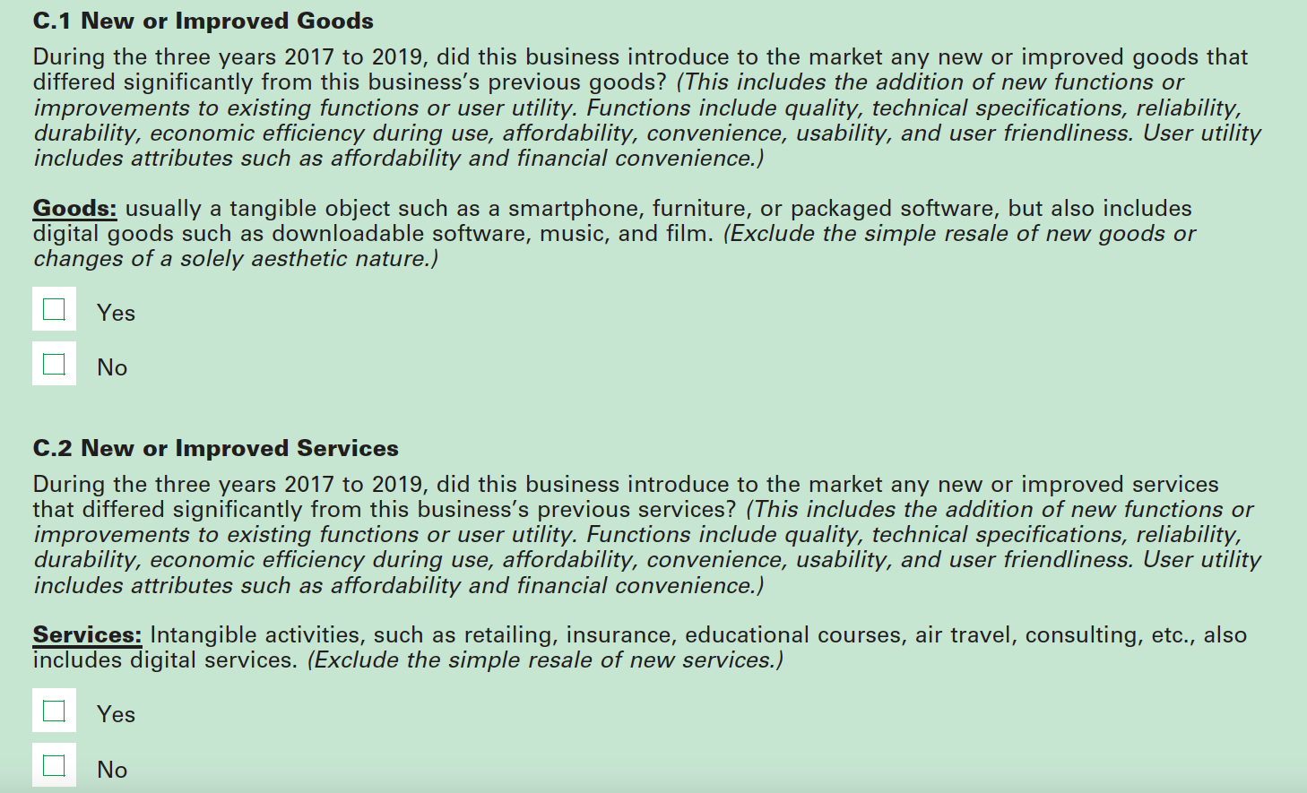
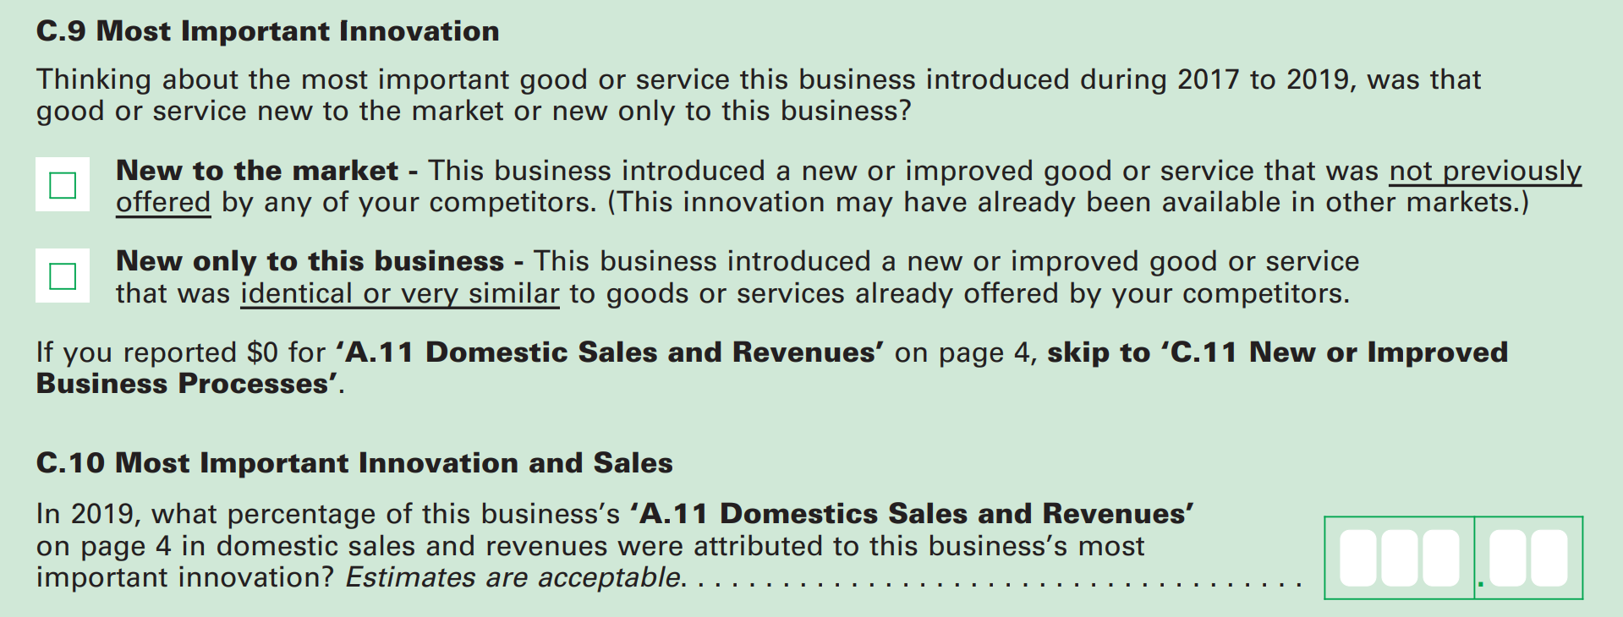
Current Measure of Innovation
EuroStat: Community Innovation Survey
Conducted every 2 years by EU member states and ESS member countries
Survey of innovation activity by enterprises
Annual Business Survey (US Census Bureau and NSF/NCSES)
Collects data on R&D, innovation, technology, intellectual property, and business owner characteristics
Annual; initial year: 2018
Previously, Business R&D Innovation Survey (BRDIS) launched in 2009
Annual Business Survey (ABS) question on innovation
Notes:
So there’s 2 standard ways that business innovation is measured and they are both surveys.
The first is EuroStat’s Community Innovation Survey, which is a survey of innovation activity by enterprises conducted every 2 years in the EU since the 1990s
The second if the Busineness R&D Innovation Survey, also known as BRDIS, which replaced the Survey of Industrial Research and Development. Launched in 2009 after a pilot in 2009
On the right, we can see how BRDIS asks about innovation [ reads question]
------ in case of questions about the survey
Other Questions:
Intent. CIS is primarily an innovation survey; BRDIS is primarily an R&D survey.
Survey context. CIS, in accordance with its intent, provides guidance on innovation and what is to be included; BRDIS provides no such guidance.
Respondent experience. CIS has been fielded many times since the 1990s, and its respondents have experience with the survey; the 2008 BRDIS pilot survey was the first time U.S.-located companies had been asked to report on their innovative activities.
Industry sectors and sizes of companies surveyed. CIS is sent to companies with 10 or more employees in industries considered to be innovative; BRDIS is a nationally representative sample of all companies with 5 or more employees in all industries.
Coverage years. Most available CIS tabulations are for the period 2004–06; BRDIS preliminary data are for the period 2006–08.
Non-response adjustments. Unit non-response is high for some countries administering the CIS, which can have a significant impact on overall rates of reported innovation; the preliminary 2008 BRDIS data were not adjusted for unit or item non-response.

Slide 3
Background and Goals
  Can we use alternative (non-survey) data sources to measure business innovation?
  While ABS measures innovation incidence, i.e., the number of
  innovating firms, we aim to test the feasibility of developing methods using
  non-traditional data to obtain richer and complementary innovation measures.
We develop natural language processing and machine learning methods using non-survey data to obtain richer and complementary innovation measures.
Focus on opportunity and administrative data (e.g., product announcements, press releases, financial filings).
What type(s) of innovation or improvement (i.e., greater efficacy, resource efficiency, reliability and resilience, affordability, convenience and usability) could be captured using opportunity data sources?
How does it vary across different companies and sectors?
Notes:
Is it possible to reliably identify the incidence of innovation in particular industries?
Which data sources and methods will allow us to quantify the number and types of new products being introduced? How can the new products be identified as innovative or not?
Are traditional data sources available for validation purposes, e.g., BRDIS survey? How accurate are our methods?
(Validation) Compare extracted metrics to ’ground-truth’ data, compute performance metrics
Can these data and methods be applied to other sectors?
(Repeatability) Apply to other sectors

Slide 4

Current Focus
Innovation Type: Product innovation as defined by the OSLO Manual
Sectors:
  Pharmaceutical and Medicine Manufacturing (NAICS 3254)
  Food Processing & Beverage Manufacturing (NAICS 311 & 3121)
  Computer Systems Design and Related Services (NAICS 5415)
Data Sources: News articles
Innovation Metrics: Number of new products/launches
by company & measures of “novelty of innovation”
Validation: Comparison of extracted metrics to ’ground-truth’ data and computation of performance metrics to
evaluate methods
Repeatability: Applying these data and methods to other sectors?
“ A product innovation is a new or improved good or service that differs significantly from the firm’s previous goods or services and that has been made available to potential users. “
Notes:
high rate of innovation
well-regulated development process
available and reliable ‘ground truth’

Slide 5
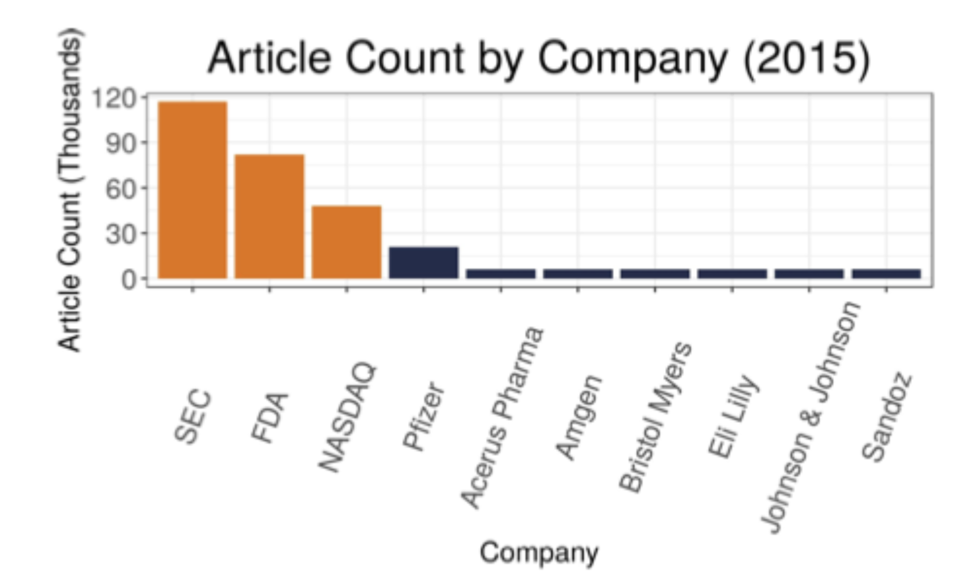
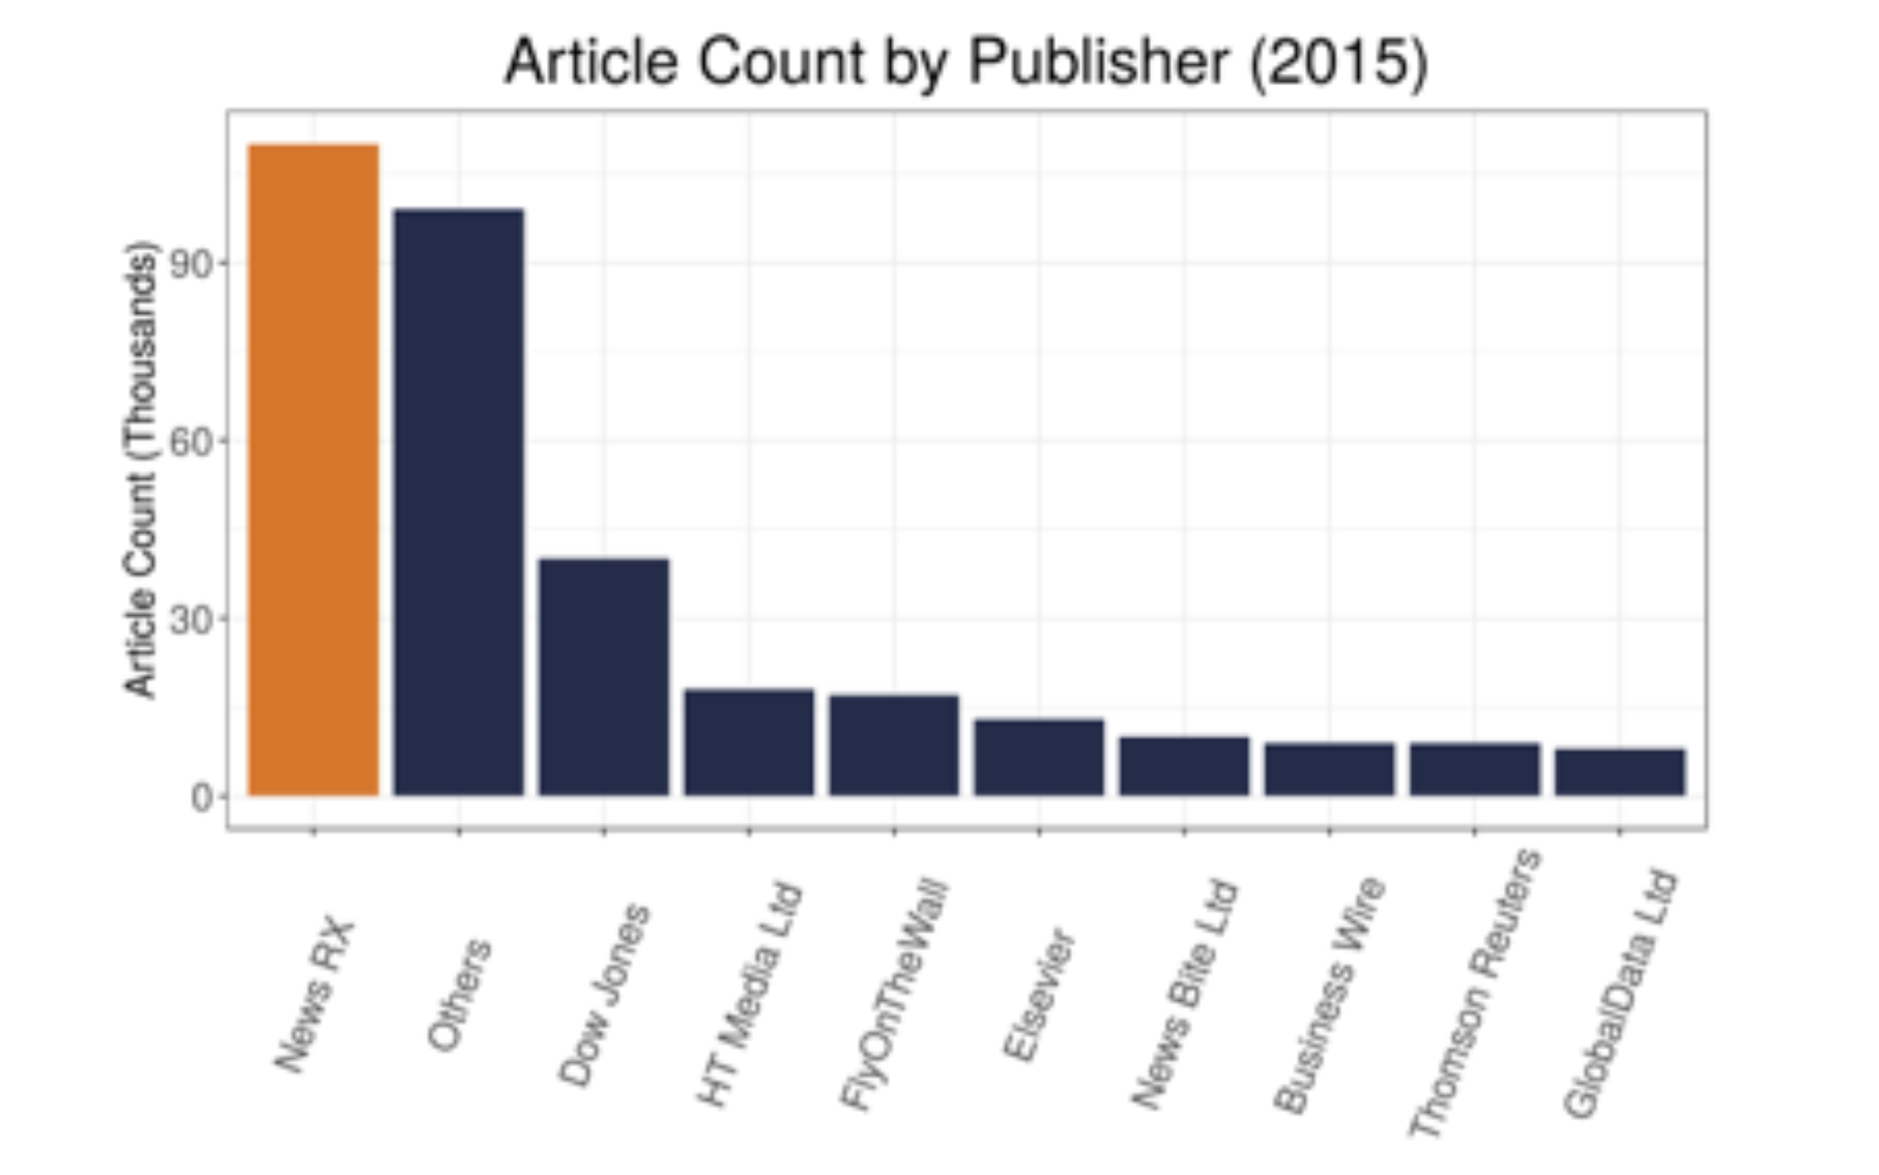
Data Sources
Pharma Articles by Company (2015)
News articles from Dow Jones Data, News, and Analytics (DNA) database
Regulatory Agencies
Companies
  English language
  Articles between 2013 and 2021
  Region Code USA
  Variables: company_codes, subject_codes, region_codes, word_count
  Additional DNA Subject Codes that can be used to further improve data selection, e.g., c22 – New Product/Service
Pharma Articles by Publisher (2015)
Sector | Number of articles
Pharmaceutical and Medicine Manufacturing (NAICS 3254) | 1.8 M (2013 - 2018)
Food Processing & Beverage Manufacturing Sectors (NAICS 311 & 3121) | 600 K (2013 - 2021)
Computer Systems Design and Related Services (NAICS 5415) | 1.2 M (2013 - 2021)
Data Obtained
Notes:
company_codes refers to the companies mentioned in the article.
subject_codes refer to the subjects mentioned in the article
region_codes refers to the global zones that the article is relevant to (Europe, North America, South America, Asia, Middle East and North Africa, Africa, Australia and Oceania)
word_count refers to the length of the article
Several of these features may be interesting to explore, to see if there are correlations between likelihood of innovation and length of the article, or presence or absence of subjects mentioned in the article.
These features are only available in processed commercial datasets like the DNA articles, and building a model that depends on these features would mean we would not be able to use plain-text articles from other sources, which is why we focused on using only the raw text data.

Slide 6
Unstructured Text Data : An Overview
Any information that doesn’t follow conventional data models, making it difficult to store and manage in a Relational Database.
Word Documents
Emails
Social Media posts
Medical notes (Healthcare NLP)
Most of this exists as ‘dark data’, data that is collected by an organization which is not used for analytics or insight generation, and is usually stored only for compliance purposes.
Notes:
Before, we dive into how we used BERT, we wanted to give a quick primer on what BERT is -> read slide, pre-trained, unsupervised: input data is not labeled

Slide 7
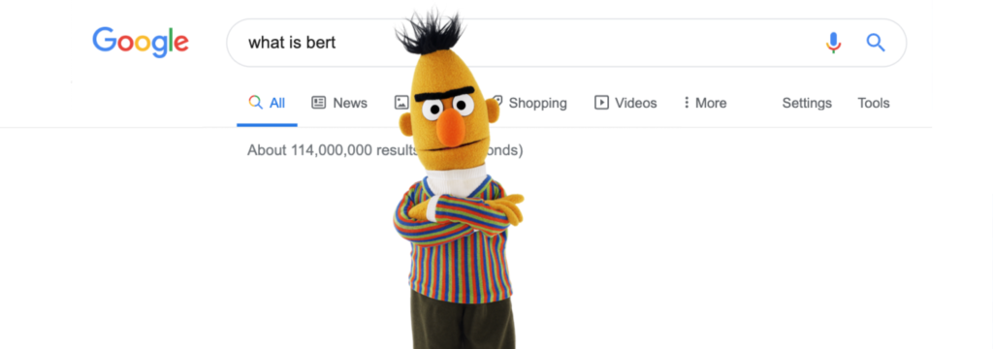
Methods: BERT
A pre-trained unsupervised Natural Language Processing model
developed by Google in 2018
Image Attribution: Bert; Sesame Workshop
Notes:
Before, we dive into how we used BERT, we wanted to give a quick primer on what BERT is -> read slide, pre-trained, unsupervised: input data is not labeled

Slide 8


BERT Benefit
Pre-trained models solve challenge of lack of enough training data
Can use pre-trained models to fine tune on smaller-task specific datasets and improves accuracy drastically
Book Corpus:
2,500 million words
Wikipedia:
800 million words
BERT Explained: A Complete Guide with Theory and Tutorials
Notes:
One of the biggest challenges in NLP is the lack of enough training data. While there is a lot of text, you would need to create task-specific datasets

Slide 9
Semantic Similarity
Language models like BERT are based on training with large data sets, such as:
full text of Wikipedia
Open Books corpus
The goal is to develop a vector representation of words, in a given sentence that represent a given idea.
These Language models contain vector representations of words, clustered by similarity of ideas in an n-dimensional vector space.
Notes:
Before, we dive into how we used BERT, we wanted to give a quick primer on what BERT is -> read slide, pre-trained, unsupervised: input data is not labeled

Slide 10
Named Entity Recognition
Named-entity recognition (NER), also known as
  (named) entity identification
  entity chunking, and entity extraction)
This is a subtask of information extraction that seeks to locate and classify named entities mentioned in unstructured text into pre-defined categories such as
  person names
  organizations, locations
  medical codes
  time expressions
  quantities
  monetary values
  percentages, etc.
Notes:
Before, we dive into how we used BERT, we wanted to give a quick primer on what BERT is -> read slide, pre-trained, unsupervised: input data is not labeled

Slide 11
Categories for NER
Normally, NER uses eight categories—location, person, organization, date, time, percentage, monetary value, and “none-of-the-above”. NER first finds named entities in sentences and declares the category of the entity. In the sentence:
“Apple [organization] CEO Tim Cook [Person] Introduces 2 New, Lager iPhones, Smart Watch at Cupertino [Location] Flint Center [Organization] Event.”
Note that “Apple” is recognized as an organization name instead of a fruit name in terms of its context.
Notes:
Before, we dive into how we used BERT, we wanted to give a quick primer on what BERT is -> read slide, pre-trained, unsupervised: input data is not labeled

Slide 12
BERT NER models
bert-base-NER is a fine-tuned BERT model that is ready to use for Named Entity Recognition and achieves state-of-the-art performance for the NER task. It has been trained to recognize four types of entities: location (LOC), organizations (ORG), person (PER) and Miscellaneous (MISC).
Specifically, this model is a bert-base-cased model that was fine-tuned on the English version of the standard CoNLL-2003 Named Entity Recognition dataset.
Notes:
Before, we dive into how we used BERT, we wanted to give a quick primer on what BERT is -> read slide, pre-trained, unsupervised: input data is not labeled

Slide 13
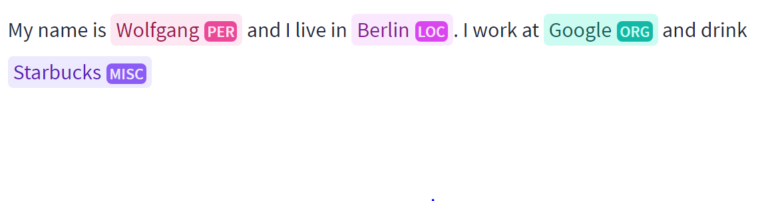
BERT - Named Entity Recognition (NER)
Identifies and categorizes entities into 4 categories based on the context that the words are used in
  Location, Person, Organization, Miscellaneous
Tokenizes words
  Craftsbury becomes Crafts## and ##bury
Uses surrounding words (Sentence context)
  John works at _______.
Is Case Sensitive
Can be further fine-tuned by training on a corpus
Tagging by huggingface model dlsim/bert-base-NER.
Notes:
We use BERT to extract “Named Entities” from text.
Identifies people, places, organizations or other words
Based on the context that the words are used in

Slide 14
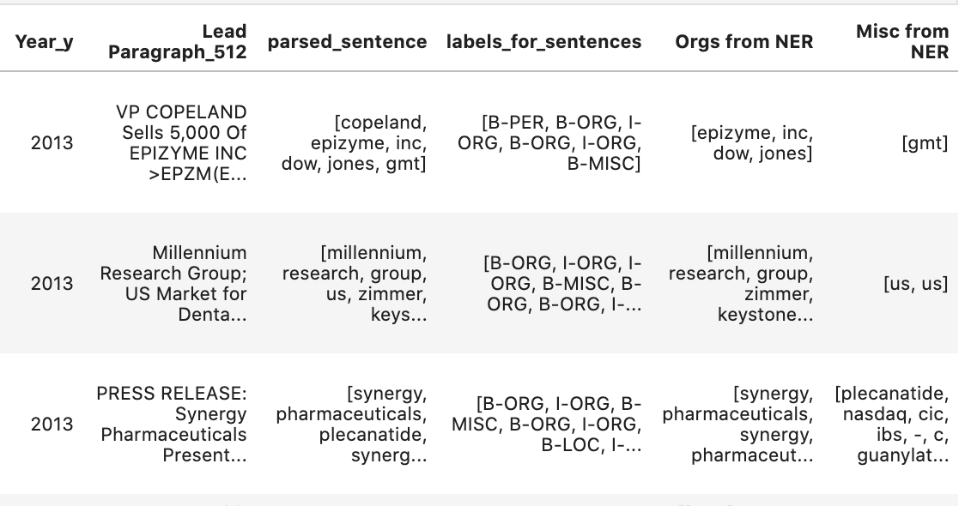
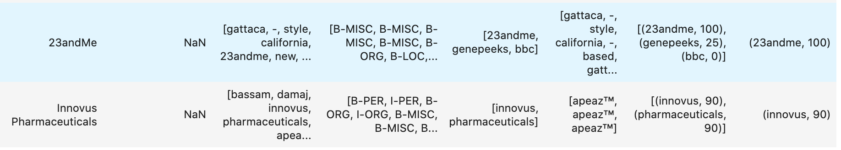
BERT - Named Entity Recognition (NER)
Use NER to extract organization names from the articles to identify company names
Fuzzy Match (fuzzywuzzy) extracted names with DNA company names to evaluate NER
Notes:
We use BERT to extract “Named Entities” from text.
Identifies people, places, organizations or other words
Based on the context that the words are used in
Company names extracted from text are not in a standardized form. This introduces an additional challenge for NER, which needs to be solved using fuzzy matching.
We use a library called ‘fuzzywuzzy’, developed by SeatGeek, that is designed to detect partial string matches between our extracted set of entities and our labeled set or standardized set of company names.

Slide 15
NER – Company Name Extraction
Performance Results for labeled data from 3 Sectors:
 | Pharma | Food & Beverage | Software
Total Number of Labeled Company Names: | 32 | 129 | 232
Exact Matches: | 12 | 36 | 112
Fuzzy Matches: | 14 | 73 | 80
Total Matches: | 26 | 109 | 192
Total Accuracy (%): | 81% | 84% | 83%
Labeled data is a random sample of articles across all available years, as mentioned in slide 10

Slide 16
Training for Additional Categories
If there are custom categories that need to be extracted, we can use transfer learning to build on the existing categories that the model is trained for, and then add training data for new categories.
Notes:
Before, we dive into how we used BERT, we wanted to give a quick primer on what BERT is -> read slide, pre-trained, unsupervised: input data is not labeled

Slide 17
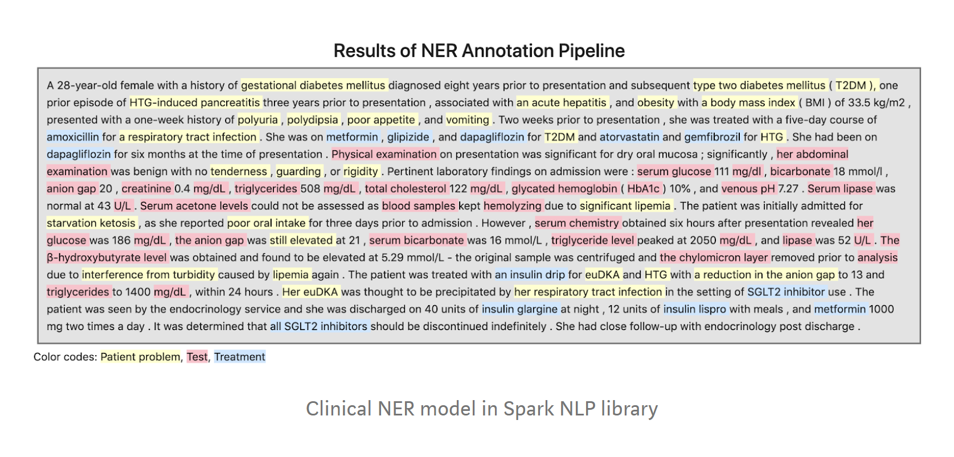
Applications of BERT:
Named Entity Recognition
https://towardsdatascience.com/named-entity-recognition-ner-with-bert-in-spark-nlp-874df20d1d77
Notes:
Image is just an image. Can’t find research project associated.

Slide 18
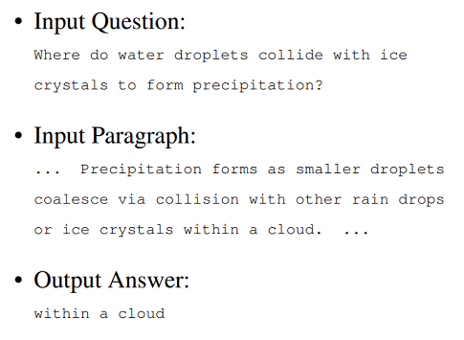
Bert - Question and Answering (QnA)
BERT uses token embedding similarities to retrieve answers to a given question, from a given reference corpus of information.
We use QnA to extract company and product names

Slide 19
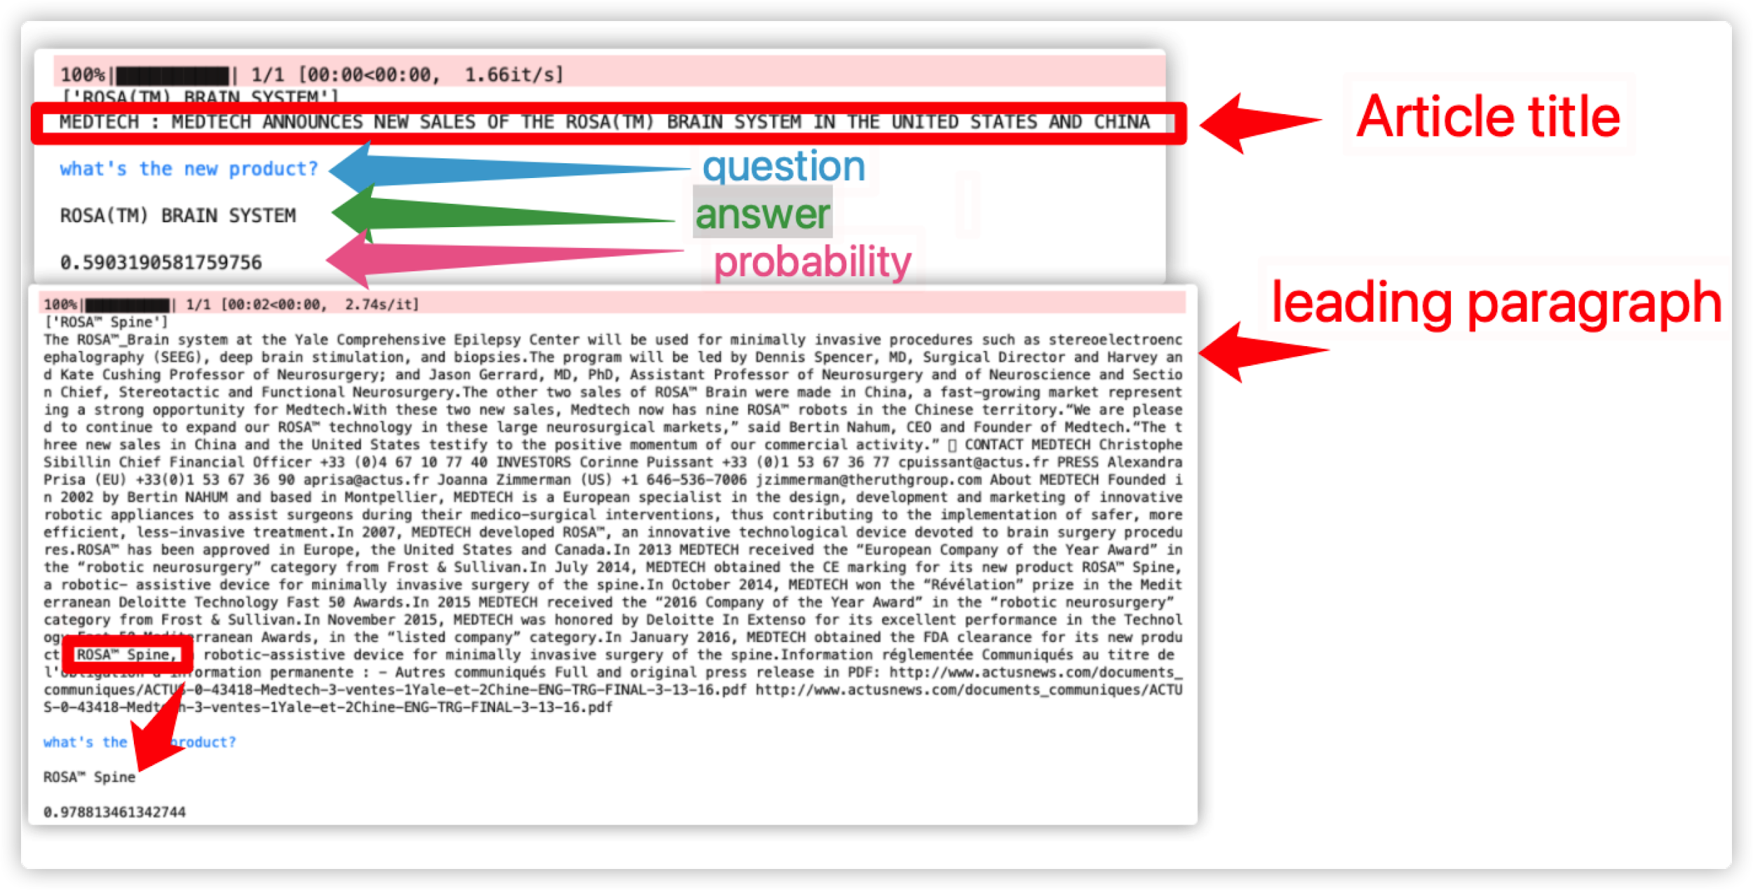
BERT - Question and Answering (QnA)
Notes:
The main task of Question Answering System is to extract the key information we need such like the name of the company, product, or devices.
This breakthrough was the result of Google research on transformers:
models that process words in relation to all the other words in a sentence, rather than one-by-one in order.
BERT models can therefore consider the full context of a word
by looking at the words that come before and after it—particularly useful for understanding the intent behind search queries.
In this examples, we have the Article title and leading paragraph passed to the model and asked the question “what’s the new product?”
Then the answer and its probability that was returned.
After pre-training, BERT works like a neural network — it passes words through a series of transformer layers (equivalent to a hidden layer in a neural network) and returns the output.
Language modelling, at its core, is gathering the probability of a word occurring in a certain context — for instance, “it’s raining cats and ___”, a language model would output ‘cat’ with the highest probability.
BERT also uses a next sentence prediction task to pretrain the model for tasks in which the understanding of the relationship between two sentences is necessary, such as for question answering

Slide 20
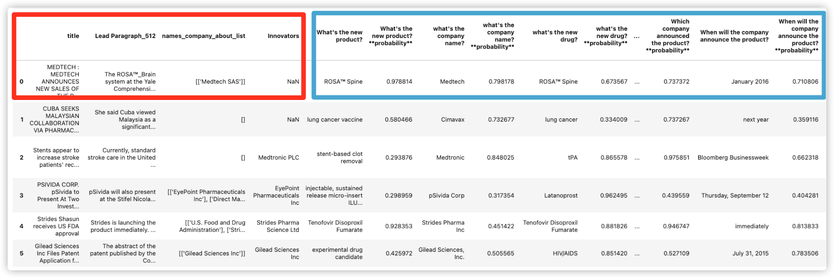
Bert - Question and Answering (QnA)
Notes:
After processing multiple articles, we organize all the result into a dataframe, each row will represent one article, the red rectangle shows the title leading paragraph, and labeled data, and at the right hand side, the blue rectangle, is all the answered and probability

Slide 21
QnA - Company and Product Extraction
Pharma | Product | Company
Total Number of Labeled Names: | 284 | 284
Exact Matches: | 140 | 88
Fuzzy Matches: | 111 | 131
Total Matches: | 251 | 219
Total Accuracy (%): | 88.3% | 77.1%

Slide 22
Thank you!
Questions & Comments?
Contact:
Thomas Neil Alexander Kattampallil (nak3t@virginia.edu)
Research Scientist
Biocomplexity Institute, University of Virginia
Acknowledgments: This material is based on work supported by U.S. Department of Agriculture (58-3AEU-7-0074) and the National Science Foundation (Contract #49100420C0015)
Disclaimer: The views expressed in this paper are those of the authors and not necessarily those of their respective institutions.
Notes:
That s all we had, now we can open it to Q&A.

Slide 23
Question Answering
Our approach to choosing the correct questions to ask for our data was to have our team come up with potential good questions and test each of them, to pick those that consistently performed well in our set.
For example, to obtain the name of the innovative product in the pharma sector, some of the questions we tested included:
What’s the newly launched drug?
What is the name of the innovative product?
What is the new drugs name?
What is the innovative new product?
What is the name of the product that will be launched in the future?
Recently, new approaches have been developed that allow for language models to generate an optimal set of questions for a given answer. (Link to Question Generation)
Notes:
Before, we dive into how we used BERT, we wanted to give a quick primer on what BERT is -> read slide, pre-trained, unsupervised: input data is not labeled

Slide 24
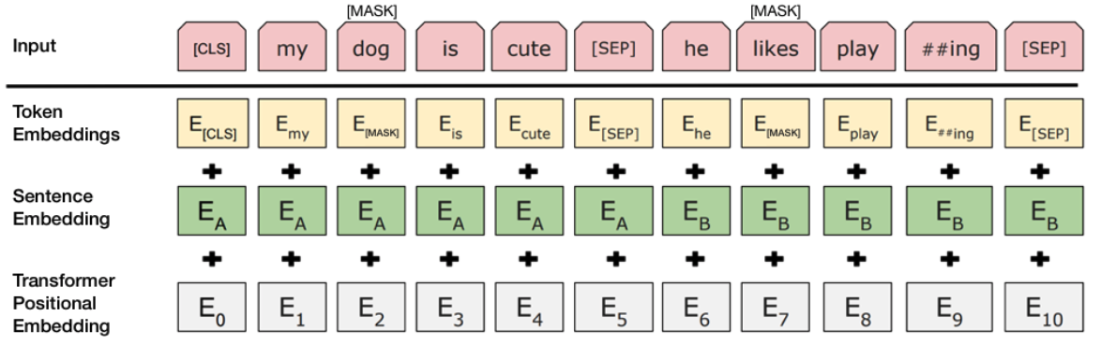
Input Schema BERT needs:
    (Devlin and others, 2019)
Token Embeddings: A [CLS] token is added to the input word tokens at the beginning of the first sentence and a [SEP] token is inserted at the end of each sentence.
Sentence Embeddings: A marker indicating Sentence B is added to each token. This allows the encoder to distinguish between sentences
Positional Embeddings: A position embedding is added to each token to indicate its position in the sentence
Notes:
Embedding: a vector of numbers for each word in vocabulary – capture meanings, relationships between words, context of different words
And so how BERT works, is it takes an input: and has 3 fdifferent types of embeddings:
Token, Sentence and transformer positional
CLS – stands for classification:
SEP: separating sentences for next sentence prediction task
3 different types of embeddings:
Token: word or tokens of word-> play vs playing
So BERT will randomly MASK a word in the sentence
=================================
CLS: stands for classification
[SEP]: is for separating sentences for the next sentence prediction task. “http://mlexplained.com/2019/01/07/paper-dissected-bert-pre-training-of-deep-bidirectional-transformers-for-language-understanding-explained/”
Image is from paper: https://arxiv.org/pdf/1810.04805.pdf
“As input, BERT takes token embeddings as well as a couple of additional embeddings that provide some crucial metadata. One of these embeddings is the positional embedding. One limitation of the Transformer architecture is that - unlike RNNs - it cannot take the order of the inputs into account (i.e. it will treat the first and last tokens of the inputs exactly the same if they are the same word). To overcome this problem, BERT learns and uses positional embeddings to express the position of words in a sentence. These embeddings are added to the token embeddings before feeding them into the model.
BERT also takes segment embeddings as input. BERT can be trained on sentence pairs for tasks that take sentence pairs as input (e.g. question answering and natural language inference). It learns a unique embedding for the first and second sentences to help the model distinguish between the sentences.” - http://mlexplained.com/2019/01/07/paper-dissected-bert-pre-training-of-deep-bidirectional-transformers-for-language-understanding-explained/
Sentence Embeddings can also be referenced as segment embeddings!

