Slide 1
Adding Interpretation to Wastewater Viral Load Monitoring
Network Systems Science & Advanced Computing
Biocomplexity Institute & Initiative
University of Virginia
March 1st 6th, 2023
Biocomplexity Institute Technical report: TR BI-2023-23
biocomplexity.virginia.edu

Slide 2
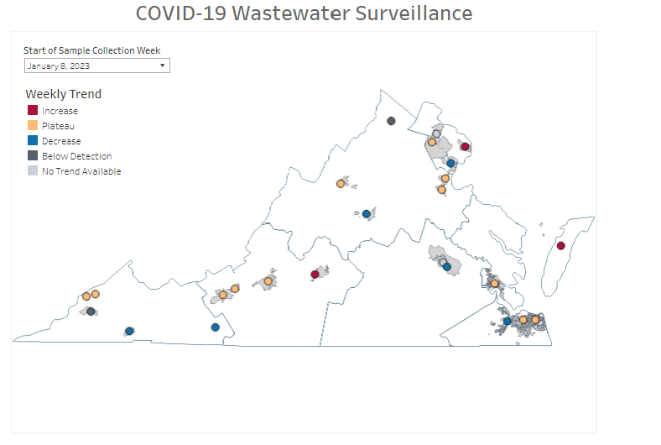
Wastewater Summary - VDH

Slide 3
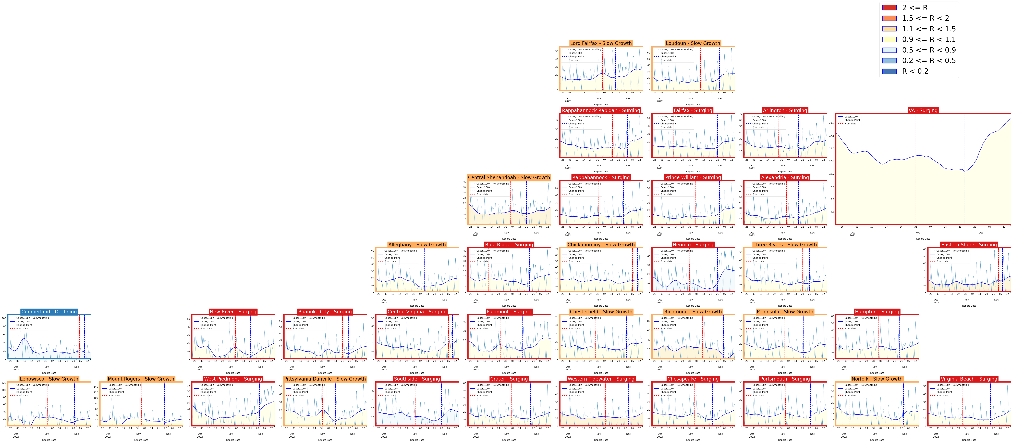
Evaluation of Trends in Wastewater and Case Trajectories
VDH Wastewater Trends
Case-based Trajectories

Slide 4
Overall Distribution of Categories
Case-based Trajectory

Slide 5
Daily cases Vs. Weekly Viral load
Aquia: 92,000; coeff: 0.893
Pound: 1,090; coeff: 0.152
Virginia Initiative Plant: 192,347; coeff: 0.858
Wolf Creek: 7,300; coeff: 0.247
Roanoke: 300,000; coeff: 0.854
Coeburn Norton Wise: 14,000; coeff: 0.401

Slide 6
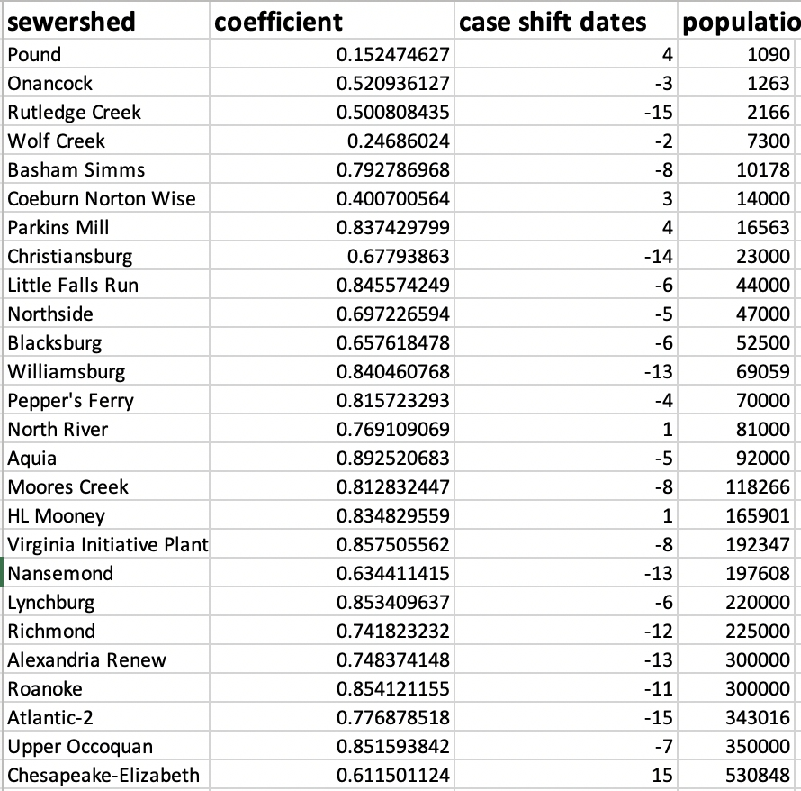
Correlation Results

Slide 7
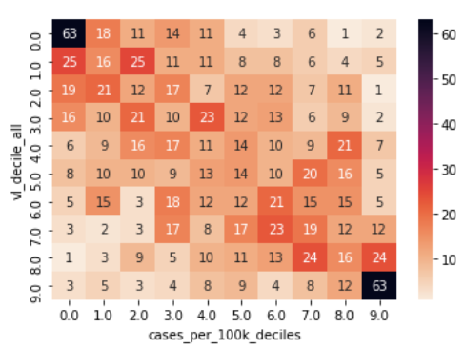
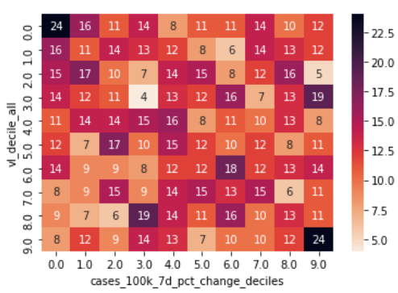
Cases and Viral Load
Case Rate Deciles &
Viral Load Deciles
These Analyses are done at the sewershed level, but aggregated to state level to provide overview of the effects
Case Rate: Cases per 100K per week experienced within the sewershed
Case Rate Quantiles: Within a sewershed categorize the history of Case Rates into quantiles, equal numbers of either 10 (deciles) or 5 (quintiles)
Case Rate Changes: Week over week % change of cases per 100K per week within the sewershed
Case Rate Change Quantiles: Case Rate Changes, but similarly quantized into deciles or quintiles.
Case Rate Changes Deciles &
Viral Load Deciles

Slide 8
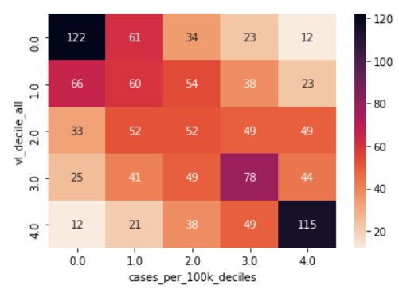
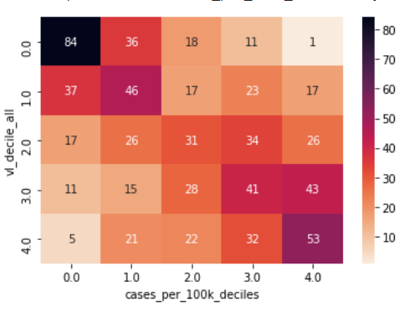
Case Rates by Viral Load
Whole History
Post-Omicron BA.1

Slide 9
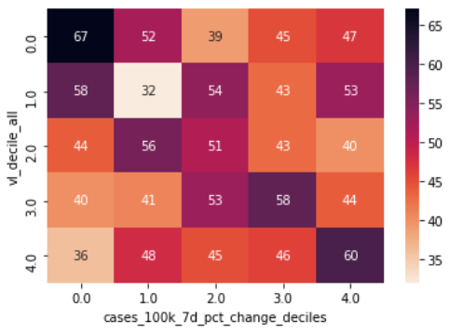
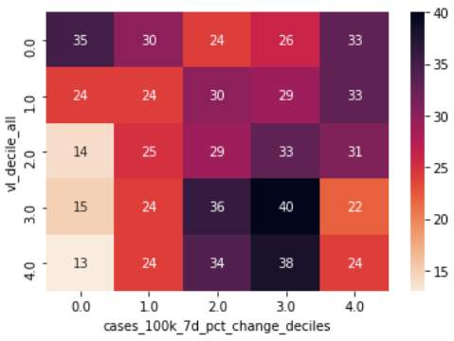
Case Changes by Viral Load
Whole History
Post-Omicron BA.1

Slide 10
Simple Risk Assessment Approach – Odds Ratio
Generate an Odds Ratio to assess impacts on Case Rate
Use the Viral load categories as a categorical measure of exposure
Use Case Rate or Case Rate Change categories as a measure of Impact (affected or not affected)
D
B
$$Odds Ratio={\left(\frac{A}{C}\right)}/{\left(\frac{B}{D}\right)}$$
C
A

Slide 11
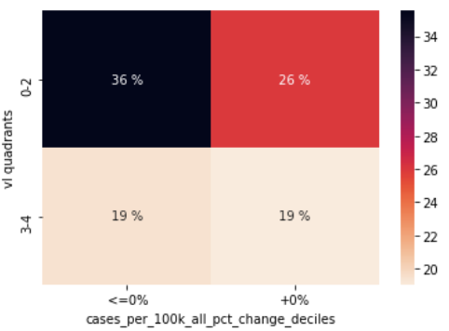
Simple Risk Assessment Interpretation
Generate an Odds Ratio (overall) to assess impacts on Case Rate
Odds Ratio = 1.3
As of 12-25-2021
Allows an interpretation along the lines:
“When your viral load is in the upper two quintiles you are 1.3 times more likely to experience an increase in cases in the following week”
Whole History Occurrence

Slide 12
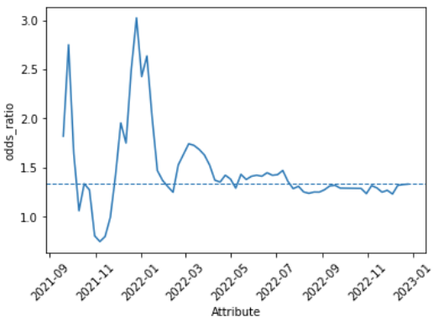
Simple Risk Assessment Interpretation
This Odds Ratio is stable regardless of where the level of exposure threshold is chosen, meaning more Viral Load compared to less Viral Load is more likely to have an increase in cases in the following week
Odds ratio is relatively stable over time (post-Omicron), showing stability as a metric
Decile Thresholds
Odds Ratio Over Time
Viral Load Decile Threshold | Odds Ratio | Confidence Interval
1 | 1.20 | [0.83 - 1.73]
2 | 1.20 | [0.91 - 1.59]
3 | 1.29 | [1.00 - 1.65]
4 | 1.17 | [0.93 - 1.48]
5 | 1.27 | [1.01 - 1.60]
6 | 1.33 | [1.05 - 1.68]
7 | 1.19 | [0.93 - 1.53]
8 | 1.18 | [0.89 - 1.57]
9 | 1.17 | [0.80 - 1.71]

Slide 13
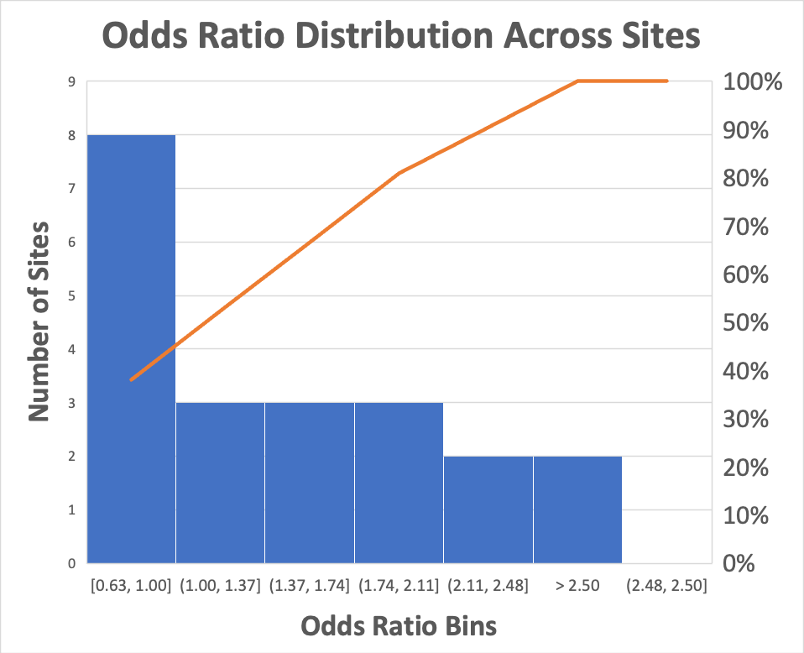
Simple Risk Assessment Interpretation
The individual site Odds Ratio (using upper 2 quintiles threshold) shows more variability, the majority of sites have greater than 1 odds ratio though all have wide confidence bounds.
Thresholds could be customized per site at the cost of increased complexity
Sewershed Sites | Odds Ratio | Confidence Interval
Alexandria Renew | 1.45 | [0.51 - 4.19]
Aquia | 2.92 | [1.01 - 8.45]
Blacksburg | 0.76 | [0.26 - 2.21]
Christiansburg | 0.69 | [0.19 - 2.47]
Coeburn Norton Wise | 1.53 | [0.53 - 4.38]
HL Mooney | 1.86 | [0.67 - 5.17]
Little Falls Run | 2.46 | [0.86 - 7.09]
Lynchburg | 1.08 | [0.38 - 3.06]
Nansemond | 0.93 | [0.32 - 2.67]
North River | 0.68 | [0.23 - 1.98]
Onancock | 2.10 | [0.72 - 6.16]
Parkins Mill | 0.88 | [0.27 - 2.86]
Pepper's Ferry | 0.63 | [0.21 - 1.84]
Pound | 0.96 | [0.33 - 2.76]
Richmond | 0.92 | [0.34 - 2.53]
Rutledge Creek | 1.53 | [0.45 - 5.25]
Town of Purcelville | 2.29 | [0.66 - 7.96]
Upper Occoquan | 1.25 | [0.45 - 3.49]
Virginia Initiative Plant | 1.82 | [0.63 - 5.24]
Williamsburg | 3.75 | [1.24 - 11.3]
Wolf Creek | 1.20 | [0.43 - 3.35]

Slide 14
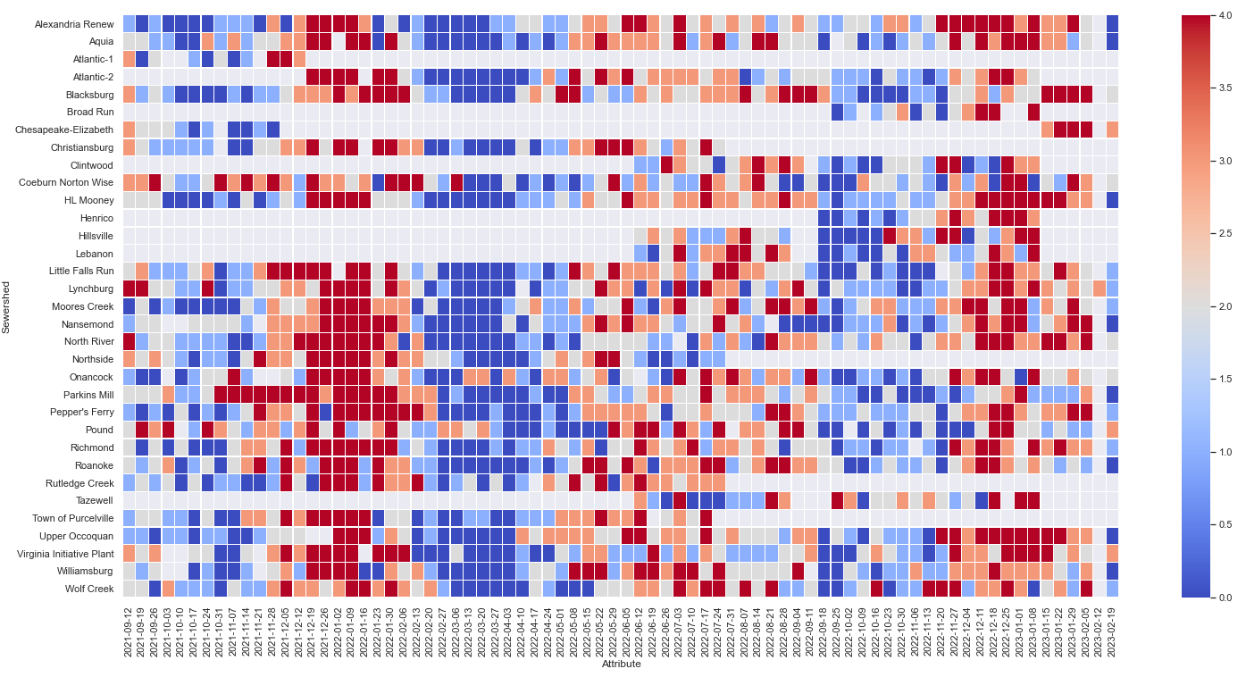
Wastewater Monitoring – UVA Generated
Wastewater signals from Virginia Sites
Three sites (of 17 reporting) are currently experiencing viral loads that are at higher risk for increased case loads in the following week
This risk is calculated
Sewershed | 2/19/2023 Quintile | current_state
Alexandria Renew | 0 | Low
Aquia | 0 | Low
Blacksburg | 2 | Low
Chesapeake-Elizabeth | 3 | High
Coeburn Norton Wise | 2 | Low
HL Mooney | 0 | Low
Little Falls Run | 1 | Low
Lynchburg | 1 | Low
Moores Creek | 1 | Low
Nansemond | 0 | Low
North River | 2 | Low
Onancock | 2 | Low
Parkins Mill | 0 | Low
Pepper's Ferry | 1 | Low
Pound | 3 | High
Richmond | 1 | Low
Roanoke | 0 | Low
Upper Occoquan | 0 | Low
Virginia Initiative Plant | 3 | High
Williamsburg | 0 | Low
Wolf Creek | 1 | Low

Slide 15
Research: Prelim Predictive Modeling

Slide 16
Wastewater vs. Hospitalization Correlation
WWTP: Alexandria Renew
Non-shift viral vs. hospitalization corr = 0.495
Non-shift viral vs. cases corr = 0.466
WWTP: Pound
Non-shift viral vs. hospitalization corr = -0.065
Non-shift viral vs. cases corr = 0.061
WWTP: Virginia Initiative Plant
Non-shift viral vs. hospitalization corr = 0.588
Non-shift viral vs. cases corr = 0.853
WWTP: Onancock
Non-shift viral vs. hospitalization corr = 0.319
Non-shift viral vs. cases corr = 0.352

Slide 17
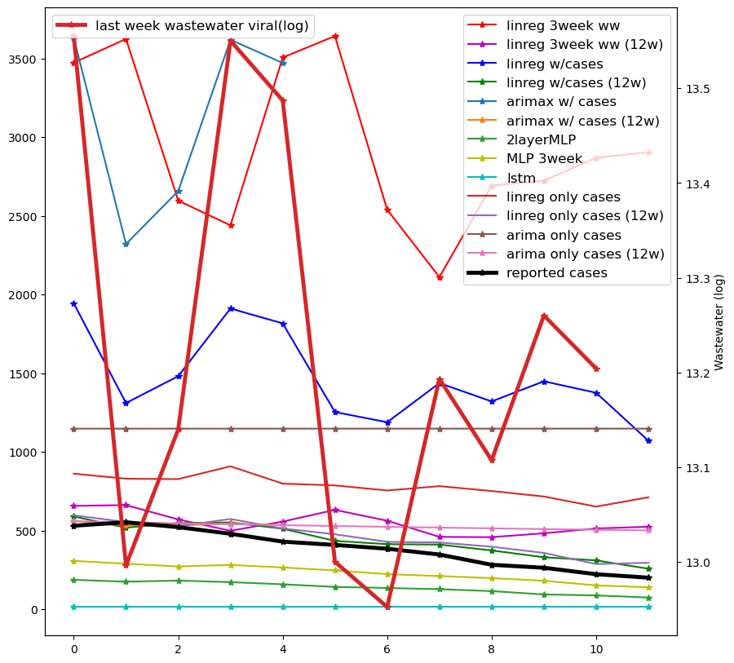
Forecast Results
linreg 3week ww
linreg 3week ww (12w)
linreg w/cases
linreg w/cases (12w)
linreg only cases
linreg only cases (12w)
arimax w/ cases
arimax w/ cases (12w)
arima only cases
arima only cases (12w)
2layerMLP
MLP 3week
lstm
<viral(t-3), viral(t-2), viral(t-1)>
Predict case(t) with linear regression
WWTP: Alexandria Renew
Train period: before 2022.3 / last 12 week in 2022
Test period: 2023.1-2023.2 (12 datapoints)
*train with viral load in log scale
<viral(t-1), case(t-1), lod(t-1)>
Predict case(t) with linear regression
<case(t-3), case(t-2), case(t-1)>
Predict case(t) with linear regression
<viral(t-1), case(t-1)>
Predict case(t) with ARIMAX
<case(t-1)>
Predict case(t) with ARIMA
<viral(t-1), case(t-1), lod(t-1)>
Predict case(t) with 2 layer MLP
<viral(t-3), case(t-3), lod(t-3),
viral(t-2), case(t-2), lod(t-2),
viral(t-1), case(t-1), lod(t-1)>
Predict case(t) with 2 layer MLP
<viral(t-3), case(t-3), lod(t-3)>
<viral(t-2), case(t-2), lod(t-2)>
<viral(t-1), case(t-1), lod(t-1)>
Predict case(t) with LSTM

Slide 18
Observations
Virginia Initiative Plant
Alexandria Renew
Obs1. Wastewater can help with the forecast compared to case alone
Obs2. Training with recent data can effectively reduce the forecast error
Obs3. Including previous reported cases can help with the forecast
Obs4. Temporal deep learning model is not effective compared with plain MLP
Obs5. Deep learning models are limited by the small training samples

Slide 19
MAPE for All Sites

