Slide 1
Data Science for the Public Good (DSPG) Young Scholars Program: Overview 2014-2021
Aaron D. Schroeder, Ph.D.
Associate Research Professor
Co-Director, DSPG
University of Virginia Biocomplexity Institute
Social Decision Analytics Division
Data Science Approaches to Health Disparities Research Symposium 2022
2022-06-22

Slide 2
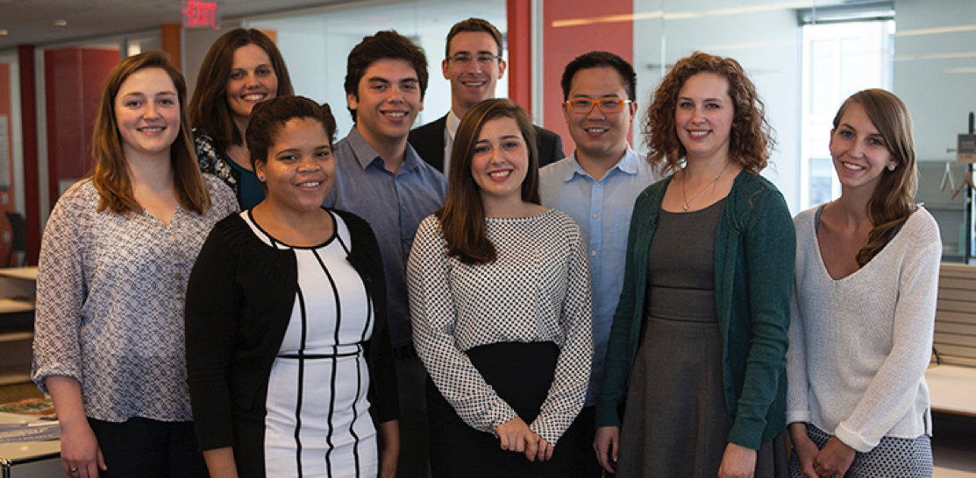
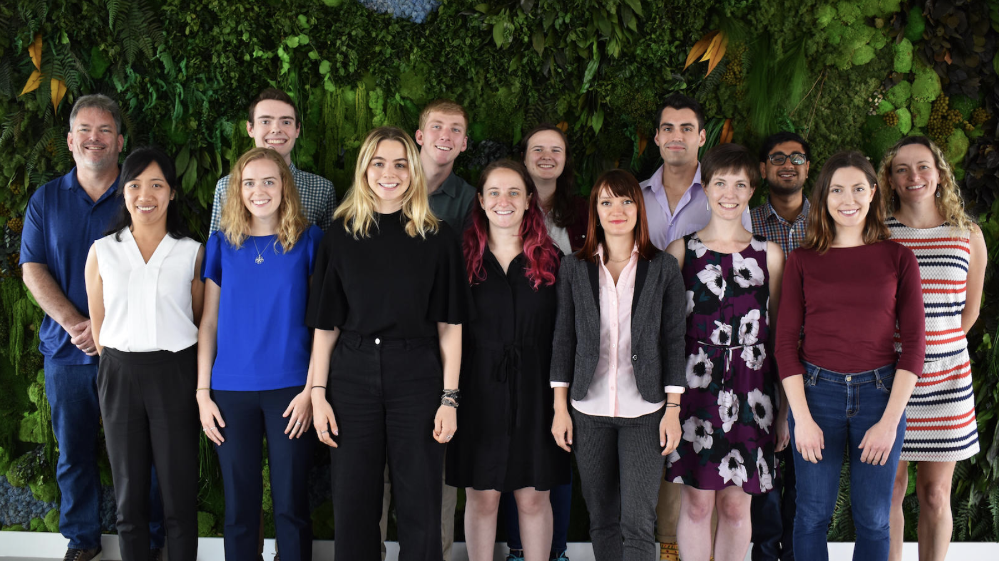
DSPG Program
The Data Science for the Public Good (DSPG) Young Scholars program equips new generations of scientists with the skills they need to inform intelligent governmental policy and decision-making.
• Graduate and undergraduate students from U.S. universities (~10-20)
• Expert training in essential data science tools and methods
• Research project teams (multidisciplinary) with dedicated graduate students, postdocs and faculty
• In collaboration with sponsors from local, state and federal governments or non-profit organizations
Notes:
This is the 9th year we’re running the Young Scholars program!
Every summer we bring together graduate and undergraduate-students from various disciplines-across-universities in the US.
The program involves an intense training that exposes them to data science tools. And at the same time, they team up to work on research projects which address real-world problems raised by policy makers.
Project teams involve a graduate student, a couple of undergrad students depending on the scope of the project, and a faculty or a postdoc from our research division who will be the main contact person of the project.
Moreover, these project teams will also have a stakeholder at a g, that is interested in the outcome of the research. The students work directly with stakeholders – which -- IS a distinguishing feature of our program. Students get to communicate with policy makers, hear their perspectives, the importance of the projects, and see how the findings & insights could be used to make policy.

Slide 3

DSPG Development Process
The Data Science for the Public Good (DSPG) program equips new generations of scientists with the skills they need to inform intelligent governmental policy and decision-making.
• Horizontally and vertically integrated team research (interdisciplinary) with dedicated graduate students, postdocs and faculty
• Undergraduate students in any discipline and graduate students (MS or PhD) with quantitative/analytical skills enrolled at any U.S. university are eligible.
• Expert training in essential tools for statistical computing, including R, Python, and GIS
• Professional training through development workshops and seminars
• Individualized mentors working closely with students
• Technical report and publication opportunities
Notes:
• The program started at Virginia Tech in 2014 and continued through 2018, now we are running it at UVA (since 2019). There have been changes in the program design over the years.
• Project teams are horizontally composed of research faculty and/or postdocs from our division, at least 1 graduate fellow, 2 undergraduate students, and a representative from the sponsoring agency (stakeholder) and vertically integrated across disciplines. We are agnostic to the data science skills for the undergraduates and to the quantitative fields of study for the graduate students.
• Graduate students lead the project teams in coordination with project PI and support the undergraduate students throughout.
• Graduate students arrive one week before the undergraduate students to get familiar with our infrastructure, learn about the projects for the summer and weigh-in on the choice of the projects they want to work on. They help and support the on-boarding of the undergraduate students and project assignments.
• The program starts with an intense training program on computational and data science skills, our computational and data operating procedures, communication, visualization, ethics, and responsible conduct of research, The training program is tailored to accommodate the highly variable backgrounds of the undergraduate students.
• There are regular weekly update meetings where every project team gives a brief update on progress and challenges. There are weekly code reviews (code merge).
• Students are assigned individual mentors whom they meet regularly (to talk about program, their projects, and career goals)
• Publication opportunities include poster presentation at the symposium, project posting on our website, brief external publication write-ups (e.g., SAGE methodspace or the Conversation), and peer-reviewed journal articles.

Slide 4
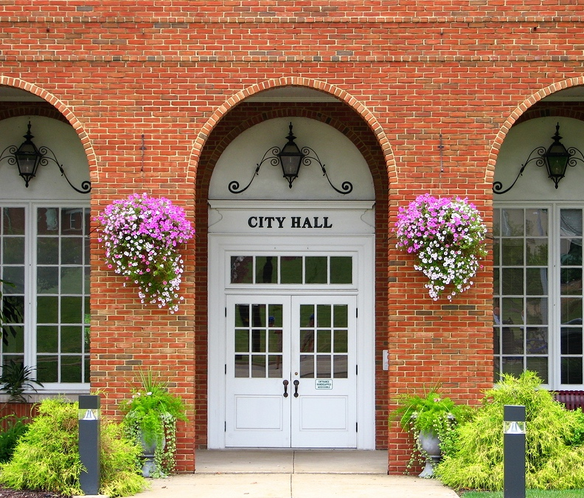

DSPG PROJECT SPONSORS / Stakeholders / partners
In collaboration with sponsors from local, state and federal governments
Local / State Government
  Federal Government Agencies
DoD: U.S. Army
  Local Government
  Arlington County, Virginia
  Fairfax County, Virginia
  State
  State Higher Education Council of Virginia
  Virginia Department of Emergency Management
  Federal Statistical Agencies
  U.S. Census Bureau
  Housing and Urban Development
  National Center for Science and Engineering Statistics
  Dept. of Defense
  Army Research Institute for Behavioral and Social Sciences
Notes:
The project should have a stakeholder willing to participate, and to interact with the project teams;
Students meet with the stakeholder at the beginning of the program to learn about the project first-hand from stakeholder and work with the stakeholder to finalize the research questions.
At least two more formal meetings will happen throughout the summer.
Someone for the sponsoring agency needs to on-hand for rapid response to questions throughout the summer.

Slide 5
DSPG DATA SCIENCE FRAMEWORK

Slide 6
DSPG Trainings Development
Getting Ready 1 SDAD Data Science Process 2 Data Security Requirements 3 Introduction to the SDAD Computing Platforms Code Management with Git 4 Naming Things 5 Project Setup, Git Setup, Git on your own 6 Git with branches for collaboration R Basics Boot Camp 7 R Notebooks 8 Strings, Factors, Numerics, Date, Times 9 Data Objects 10 Iteration (Loops and Vectorization), Functions 11 Regex Data Discovery 12 FIELD TRIP: Library of Congress LABS 13 Literature Review 14 Data Inventory & Screening Research Ethics & Behavioral Experiments 15 Research Ethics 16 Brown Bag: Data Privacy & Stakeholder Expectations 17 Behavioral Experiments Data Ingestion 18 From Files & APIs 19 From Databases & Spatial Scraping Data 20 Web-Scraping: HTML 21 Web-Scraping: Javascript Transforming (& Creating) Data 22 Restructuring on Ingest 23 Creating Data from Satellite Imagery | Data Management 24 Storage, Security, Destruction 25 Metadata Data Profiling 26 Structure 27 Quality 28 Metadata & Provenance Data Preparation 29 Restructuring 30 Cleaning 31 Transformation 32 Joining 33 Deduplication Data Exploration & Analysis 34 Exploration & Visualization 35 Mapping 36 Text Mining Media Interaction 37 Media Writing 38 Media Speaking Data Modeling 39 Modeling: Social Network Analysis 40 Modeling: Regression / GLM 41 Modeling: Classification & Clustering 42 Modeling: Decision Trees Data Presentation 43 APIs 44 Graphics Cookbook 45 Latex 46 Shiny Documents & Dashboards, part 1 47 Shiny Documents & Dashboards, part 2
DSPG trainings focus on learning data science methods and tools.
The students engage in 47 classroom training modules covering the topics.
By the end of the program, the students have learned about and used the skills learned in their projects.
All students have learned or increased their proficiency in using data science software and tools

Slide 7
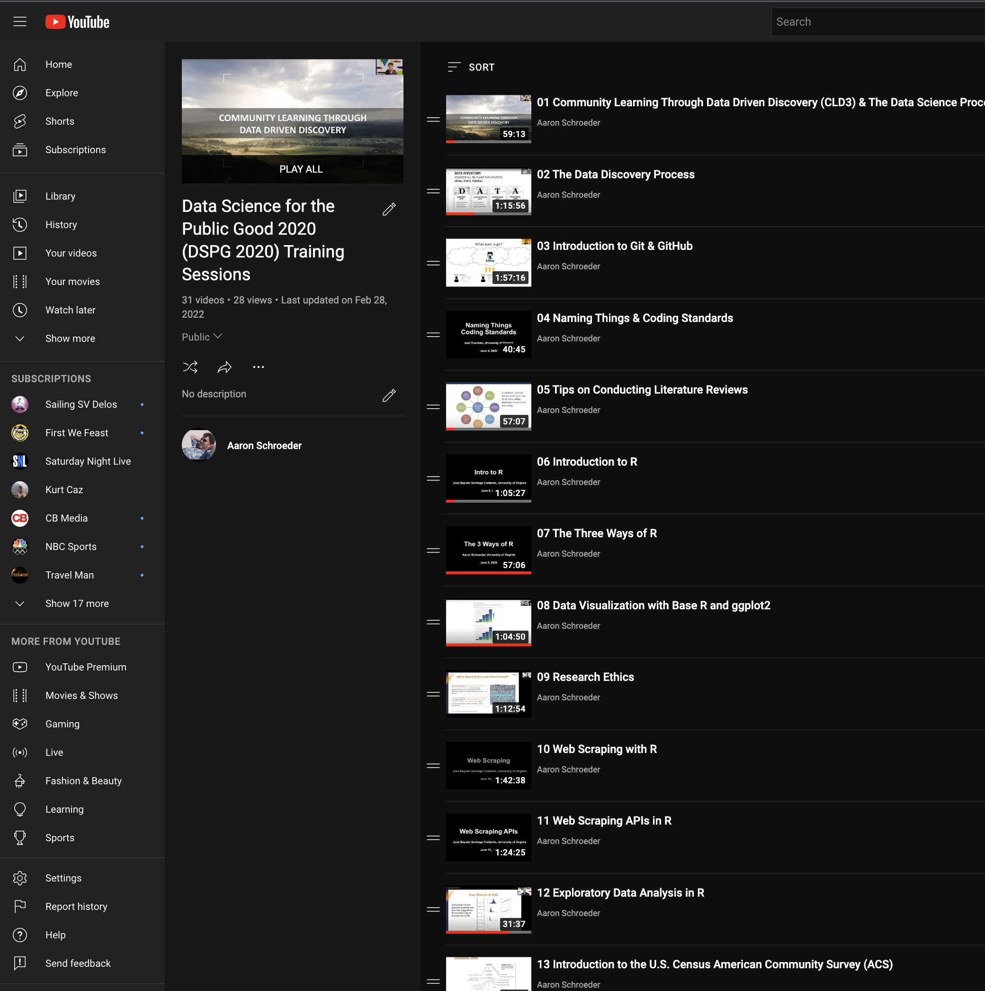
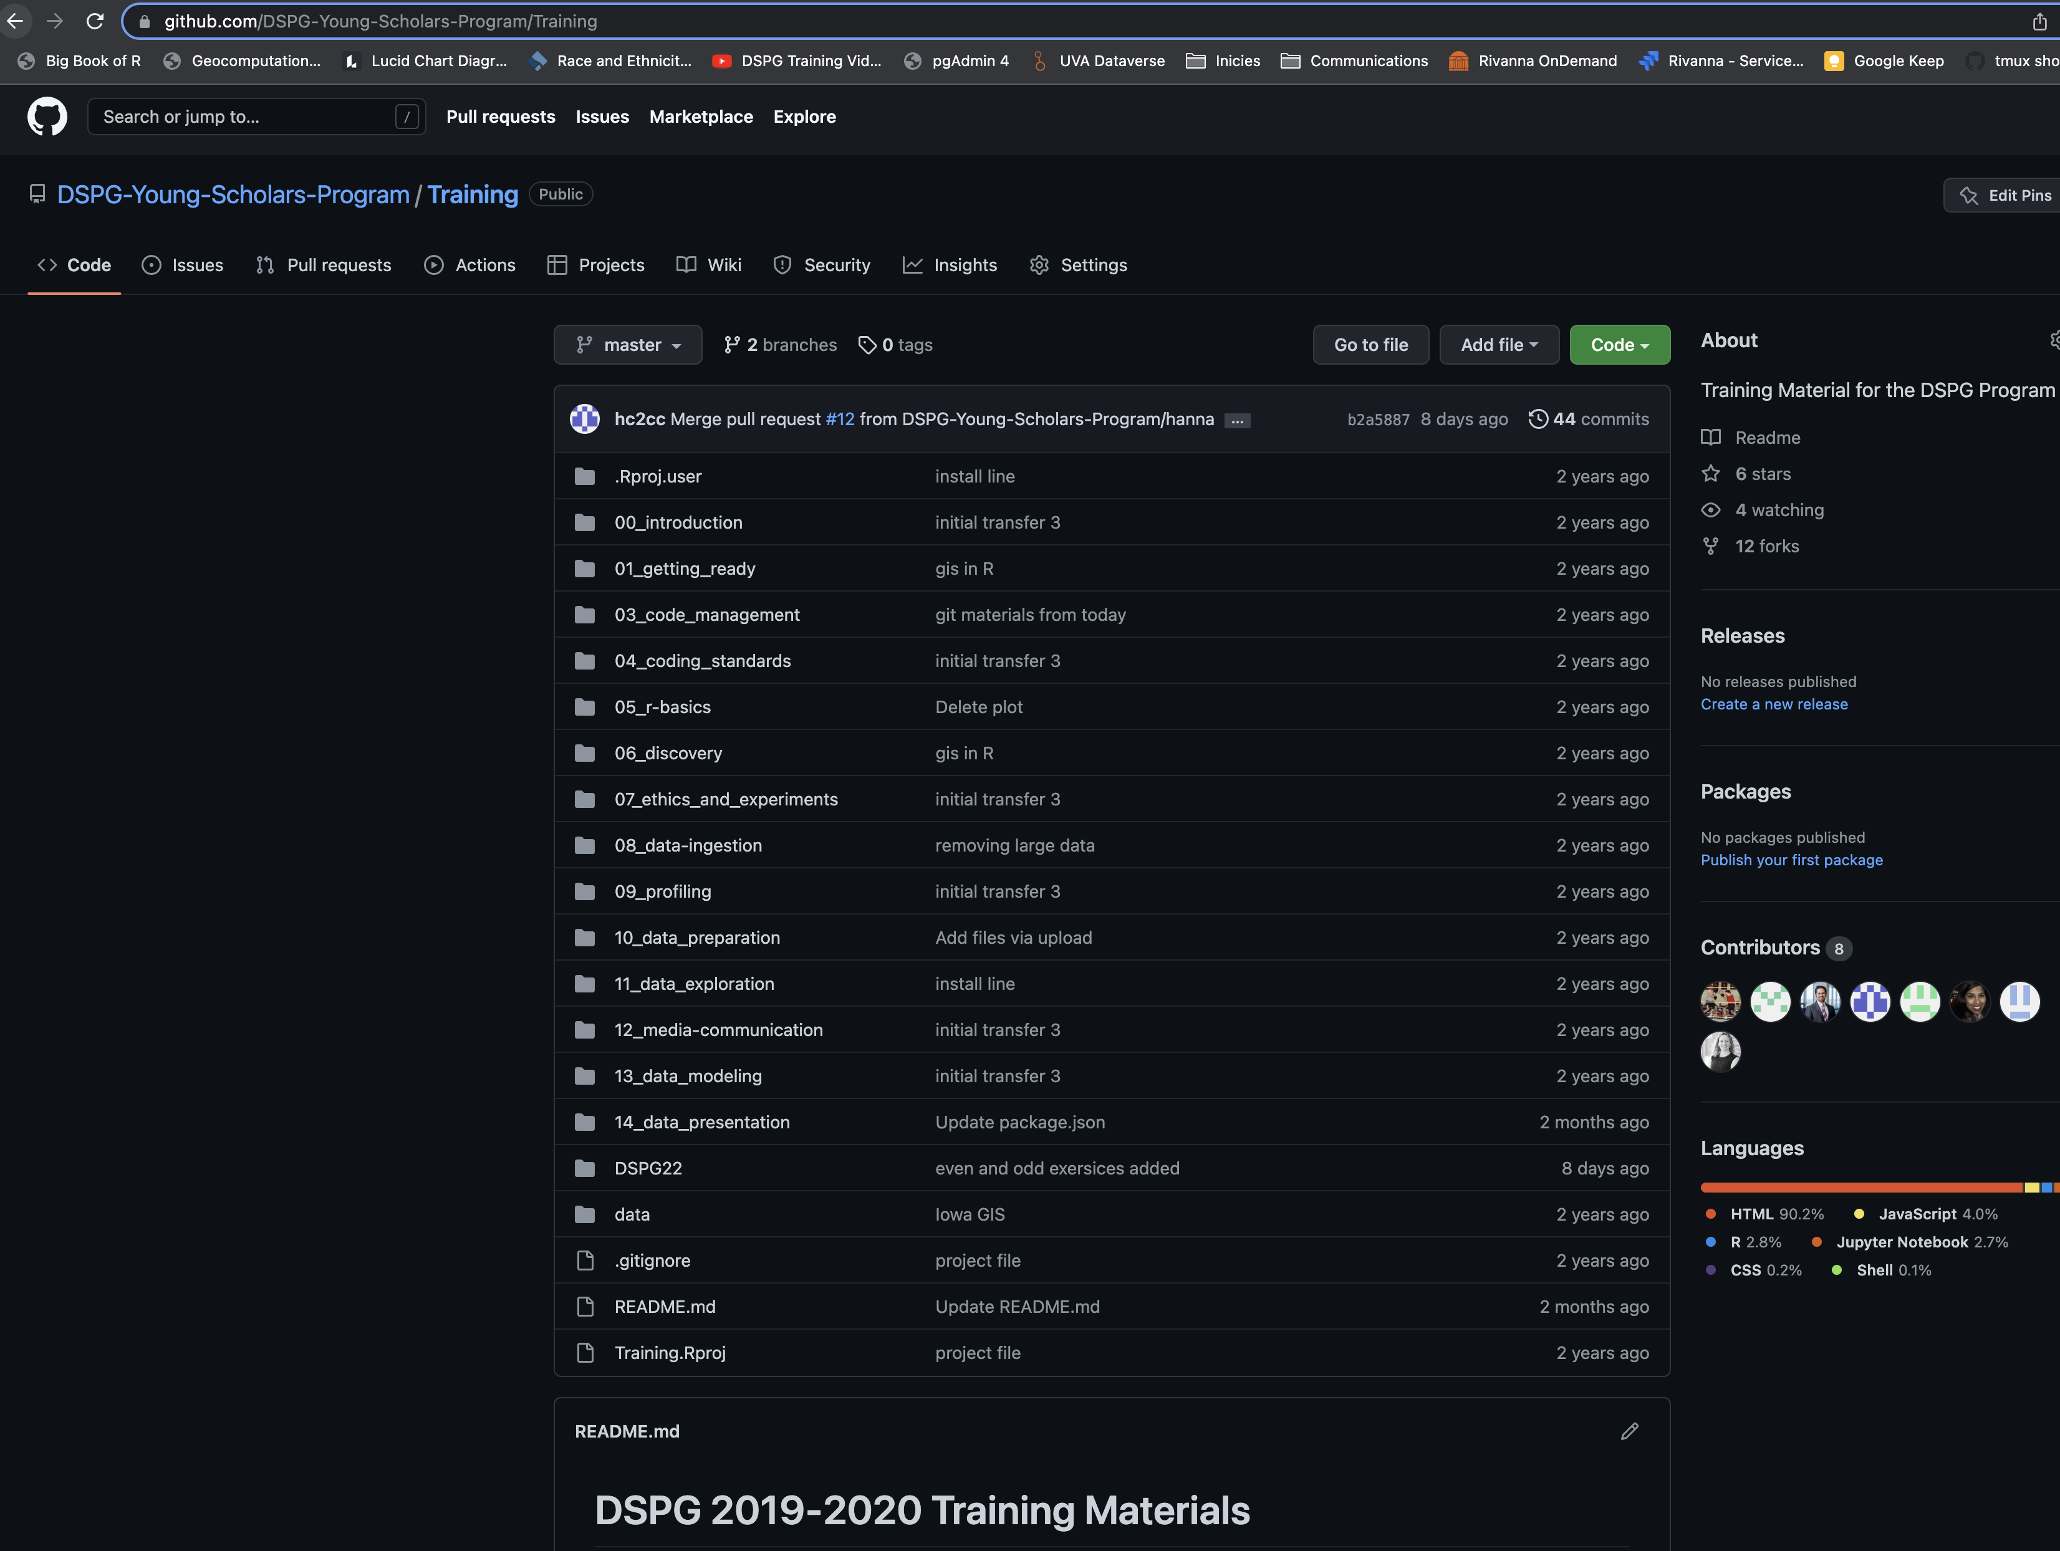
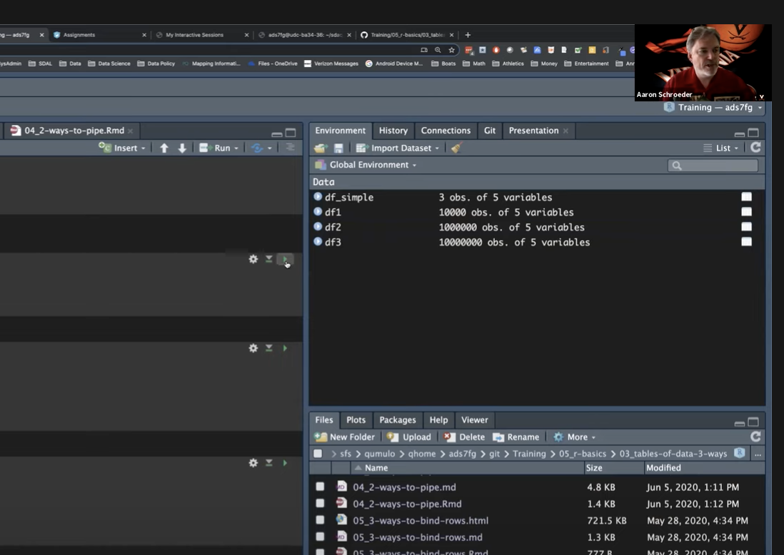
DSPG Trainings Development
https://youtu.be/G12RfEG4V-Q
https://github.com/DSPG-Young-Scholars-Program/Training

Slide 8




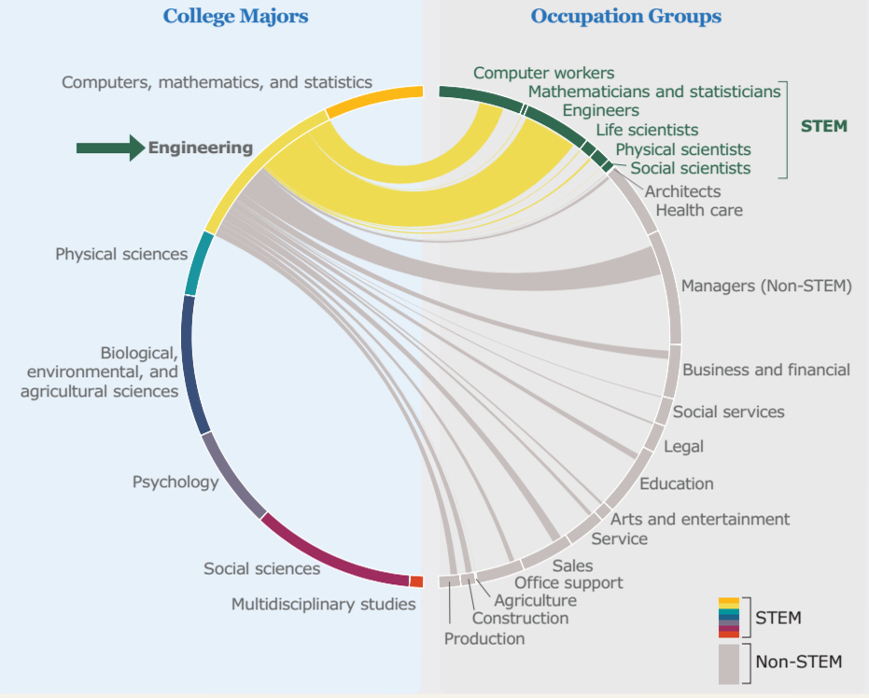
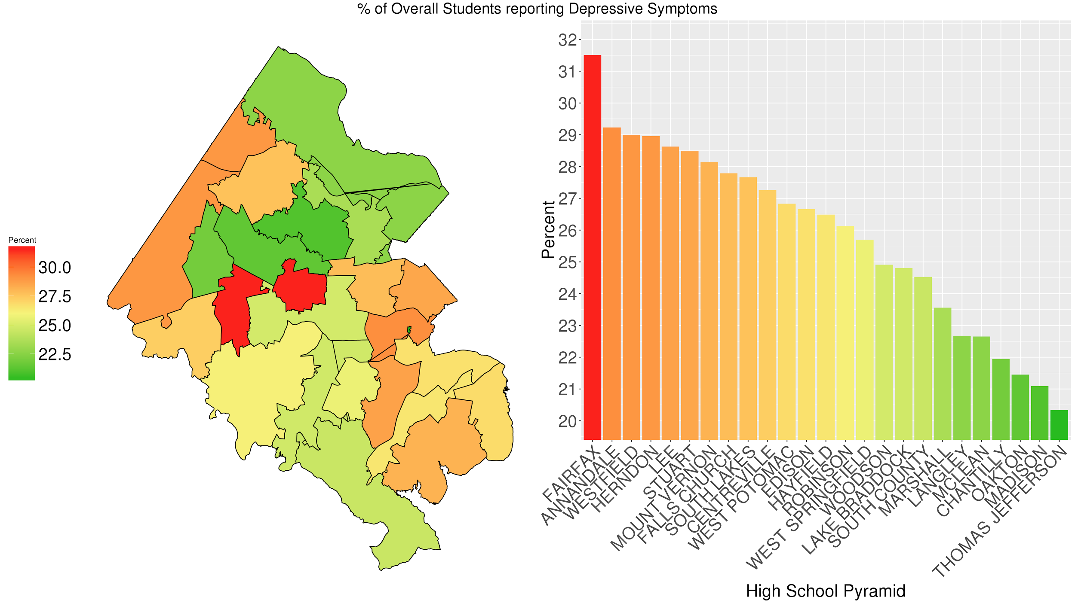
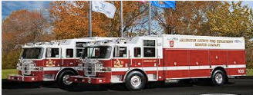



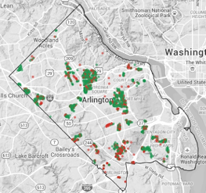
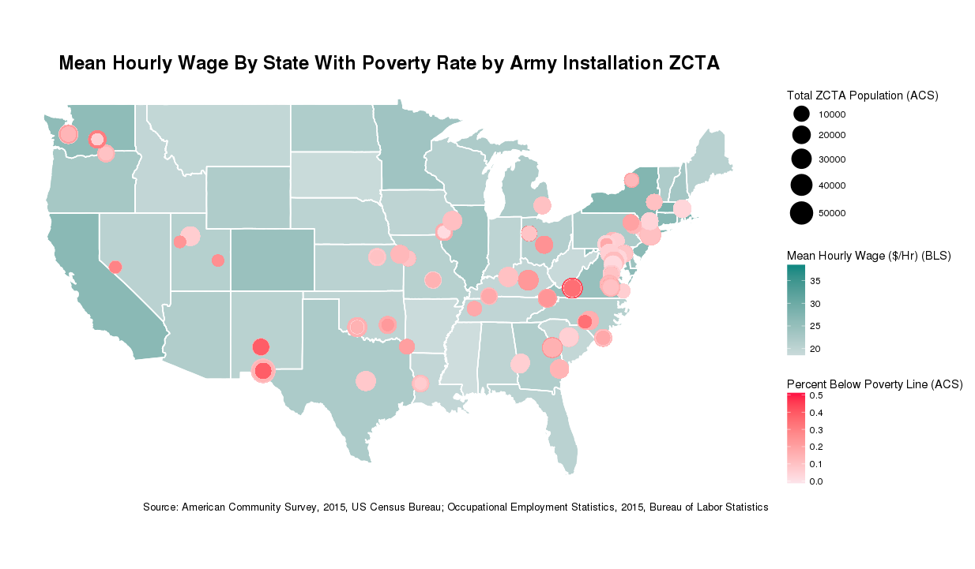
DSPG PROJECTS
https://datascienceforthepublicgood.org/events/symposium2020/poster-sessions
Notes:
The projects involve a wide range of topics., including education, public health and public safety.
As I mentioned, these problems come from agencies that we work with, it could be a local government agency, for example we work with AC Police and fire departments; it could be at the state level, such as va dept of health or education or some are federal government agencies such as the NSF and DoD
When the students arrive, the projects are presented to the students, and we ask which projects they are interested inw roking on. the project allocation will be based on students preferences and the skills required by the projects.
Each student WORKS on two projects so they get exposed to different topics and methods, and they also interaft with different students and faculty in the program.

Slide 9
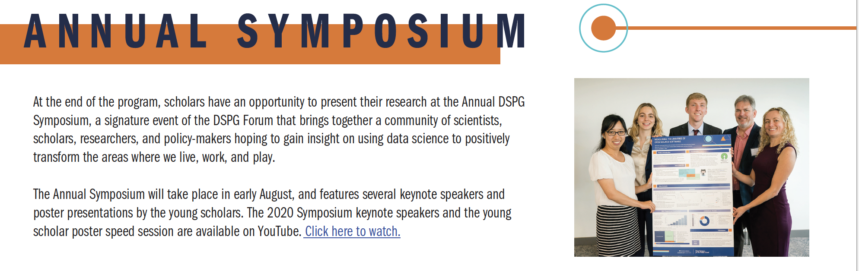
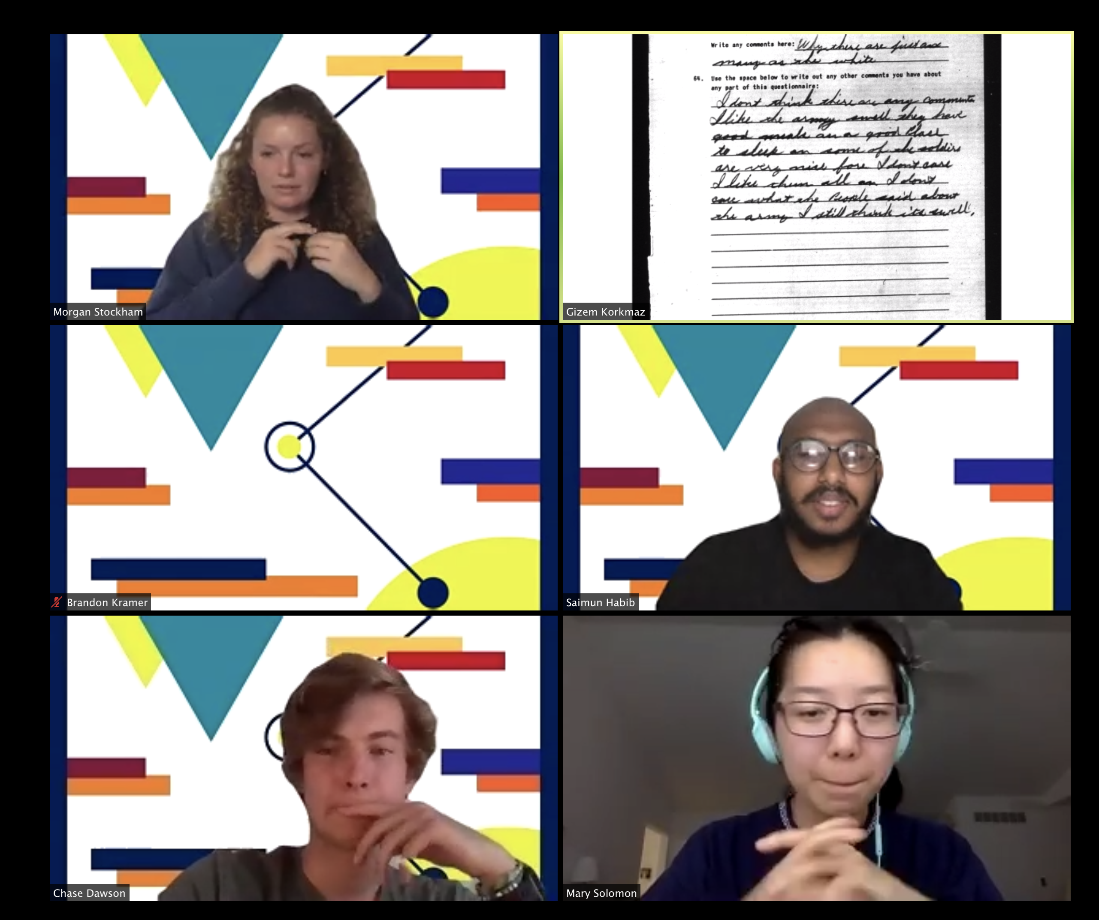
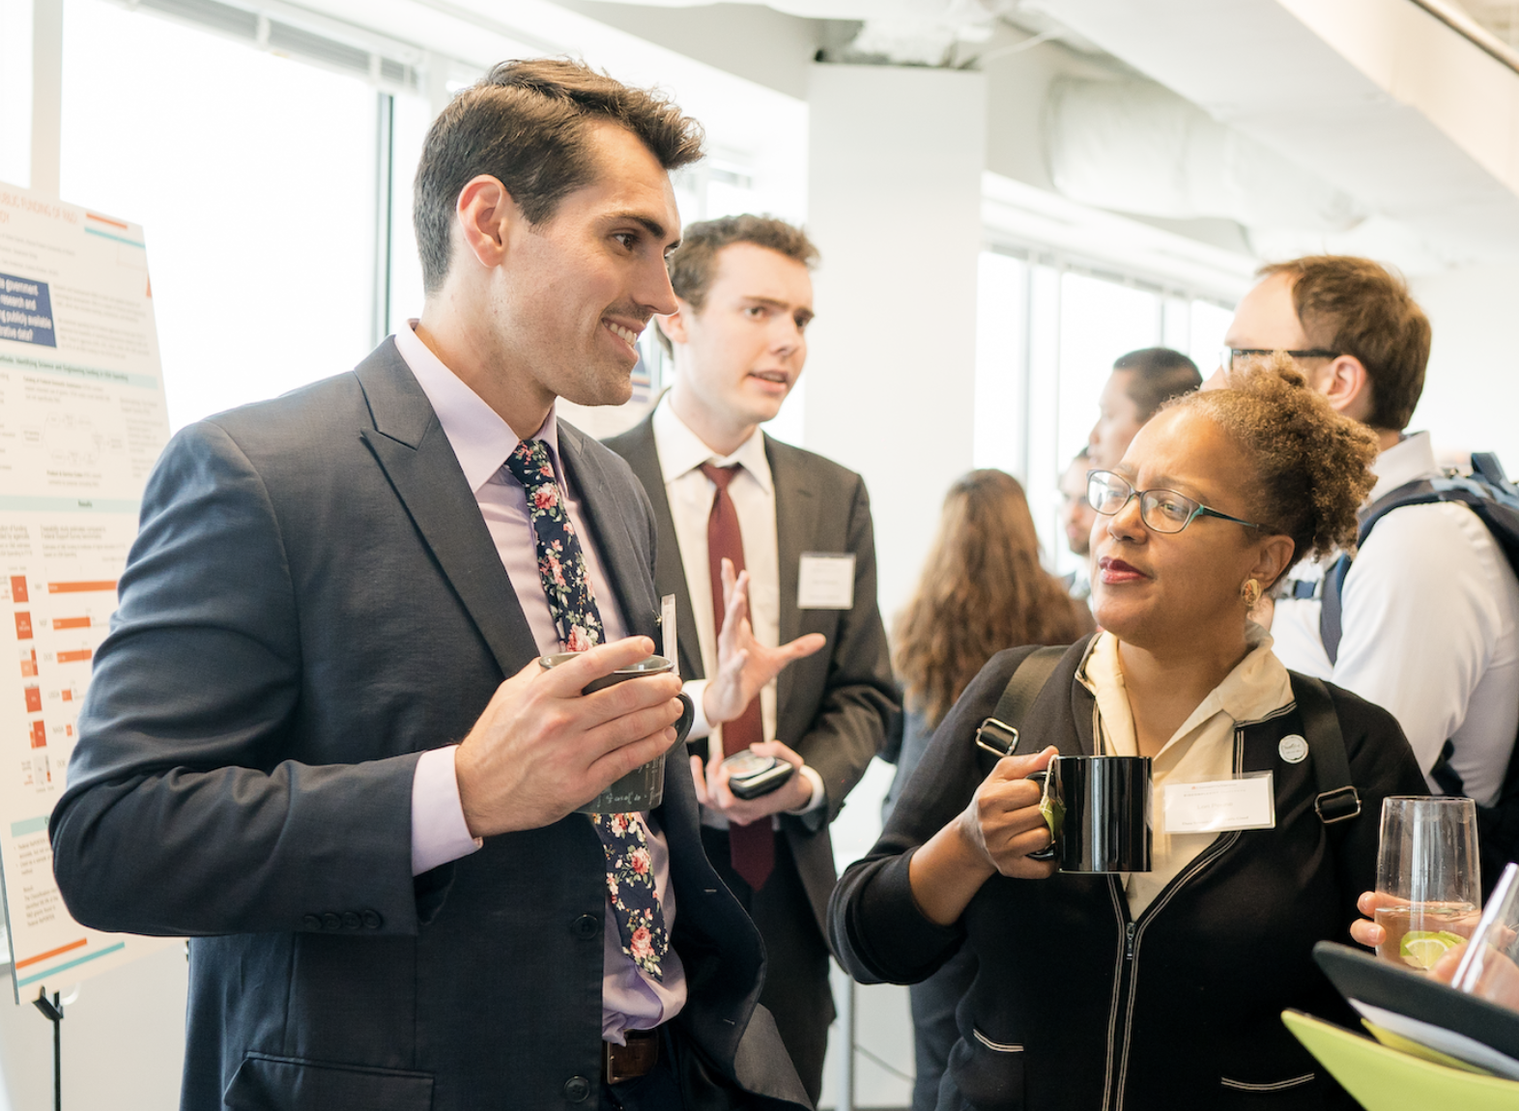
At the end of the summer program, scholars have an opportunity to present their research at the DSPG Annual Symposium
Brings together a community of scientists, scholars, researchers, and policy-makers hoping to gain insight on using data science to positively transform the areas in which we live, work, and play.
The 2019 and 2020 symposium keynote speakers and the young scholar poster speed session are available on YouTube.
Notes:
At the end of the program, we have a symposium where students present their research findings to their stakeholders, to other collaborators and researchers.
We have a large number of audience including researchers, and policy-makers. Last year we had around 300 participants as it was virtual. This provides an additional opportunity for our students as they network with the participants.

Slide 10
Expanding the Impact:
2020: Three-State Coalition for the Public Good
In January of 2020, the USDA awarded a $1 million grant to the Biocomplexity Institute to lead the development of a three-state Coordinated Innovation Network and expand the Institute’s highly successful DSPG program beyond the Commonwealth of Virginia for the first time.
The three-state Coordinated Innovation Network includes five public universities across three states: Oregon State University, Iowa State University, Virginia Tech, University of Virginia, and Virginia State University, each with its own tailored yet similar DSPG program, including a Young Scholars program.
The outcomes from the Three-State Coalition initiative have been:
  Promoting economic mobility through use of data science
  Utilizing evidence-based decision-making capacity
  Bringing data science to rural areas with a scalable, and repeatable process
  Developing new datasets and information resources for use by communities and researchers
  Empowering public services and local organizations to develop and share data to the benefit of all
  Developing programs that serve as an incubator to promote workforce development
  Opening of entrepreneurial space for the development of new products, processes, and tools based on local community data
  Boosting the quality of life, and efficient and equitable delivery of services in their communities

Slide 11
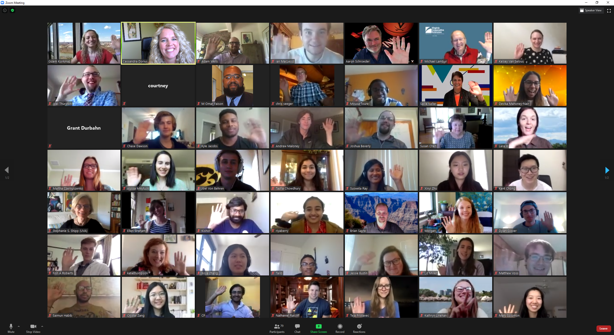
2020 – “VIRTUAL” YOUNG SCHOLARS PROGRAM
Notes:
Last two years we delivered our program virtually
How does a wee look like?
Each week we start with a group-wide check in which helps the group to coordinate.
In the first weeks, the trainings will take a lot of time, but the projects will also start which means that students will be meeting with their project teams on a regular basis. In these meetings, students will give updates about what they have been working on, and the teams decide what the next steps are and allocates the tasks to the team members. In addition to these meetings, Ugs also m,eeet with the graduate fellow t fo their projects if they need support. Students also meet with their mentors every couple of weeks.
There is a high level of interaction as the research is conducted in teams.
given the virtual nature of the program students use zoom, slack, teams and other platrofms to communicate and work together.

Slide 12
DSPG NUMBERS
 | 2014 | 2015 |  | 2016 | 2017 | 2018 | 2019 | 2020 | 2014-2020
# DSPG Students | 8 |  | 6 | 8 | 20 | 16 | 12 | 25 (64 3-state) | 95
Degree Program
Bachelors | 38% |  | 67% | 75% | 80% | 63% | 58% | 68% | 66%
Masters | 38% |  | 0% | 13% | 5% | 19% | 17% | 16% | 14%
Doctorate | 25% |  | 33% | 13% | 15% | 19% | 25% | 12% | 20%
Gender
% Male students | 38% |  | 67% | 75% | 80% | 63% | 58% | 24% | 66%
% Female Students | 38% |  | 0% | 13% | 5% | 19% | 17% | 76% | 14%
Field of Study
% Math/Stat/CS | 50% |  | 83% | 50% | 50% | 50% | 50% | 44% | 53%
% Social & Behavioral Sciences | 13% |  | 0% | 25% | 10% | 31% | 50% | 56% | 23%
% Engineering | 25% |  | 17% | 0% | 10% | 13% | 0% | 0% | 10%
% Science | 13% |  | 0% | 25% | 15% | 0% | 0% | 4% | 9%
Business | 0% |  | 0% | 0% | 15% | 6% | 0% | 4% | 6%
# Projects, Posters, Sponsors, Symposium Attendees
# DSPG projects | 7 |  | 4 | 12 | 14 | 9 | 9 | 13 (34 3-state) | 68
# DSPG posters | 7 |  | 4 | 14 | 15 | 11 | 9* | 13 | 73
# DSPG Sponsors | 5 |  | 2 | 6 | 8 | 6 | 7 | 6 | 40
# DSPG Symposium Attendees | - |  | - | 105 | 145 | 195 | 185 | 315

Slide 13
Continuing Challenges
Funding
  While needed and celebrated by participating stakeholders, existing funding mechanisms are not traditionally used to fund this type of experiential/educational program
  Constant struggle to braid funding from multiple existing projects to provide the needed support

